Slide 1
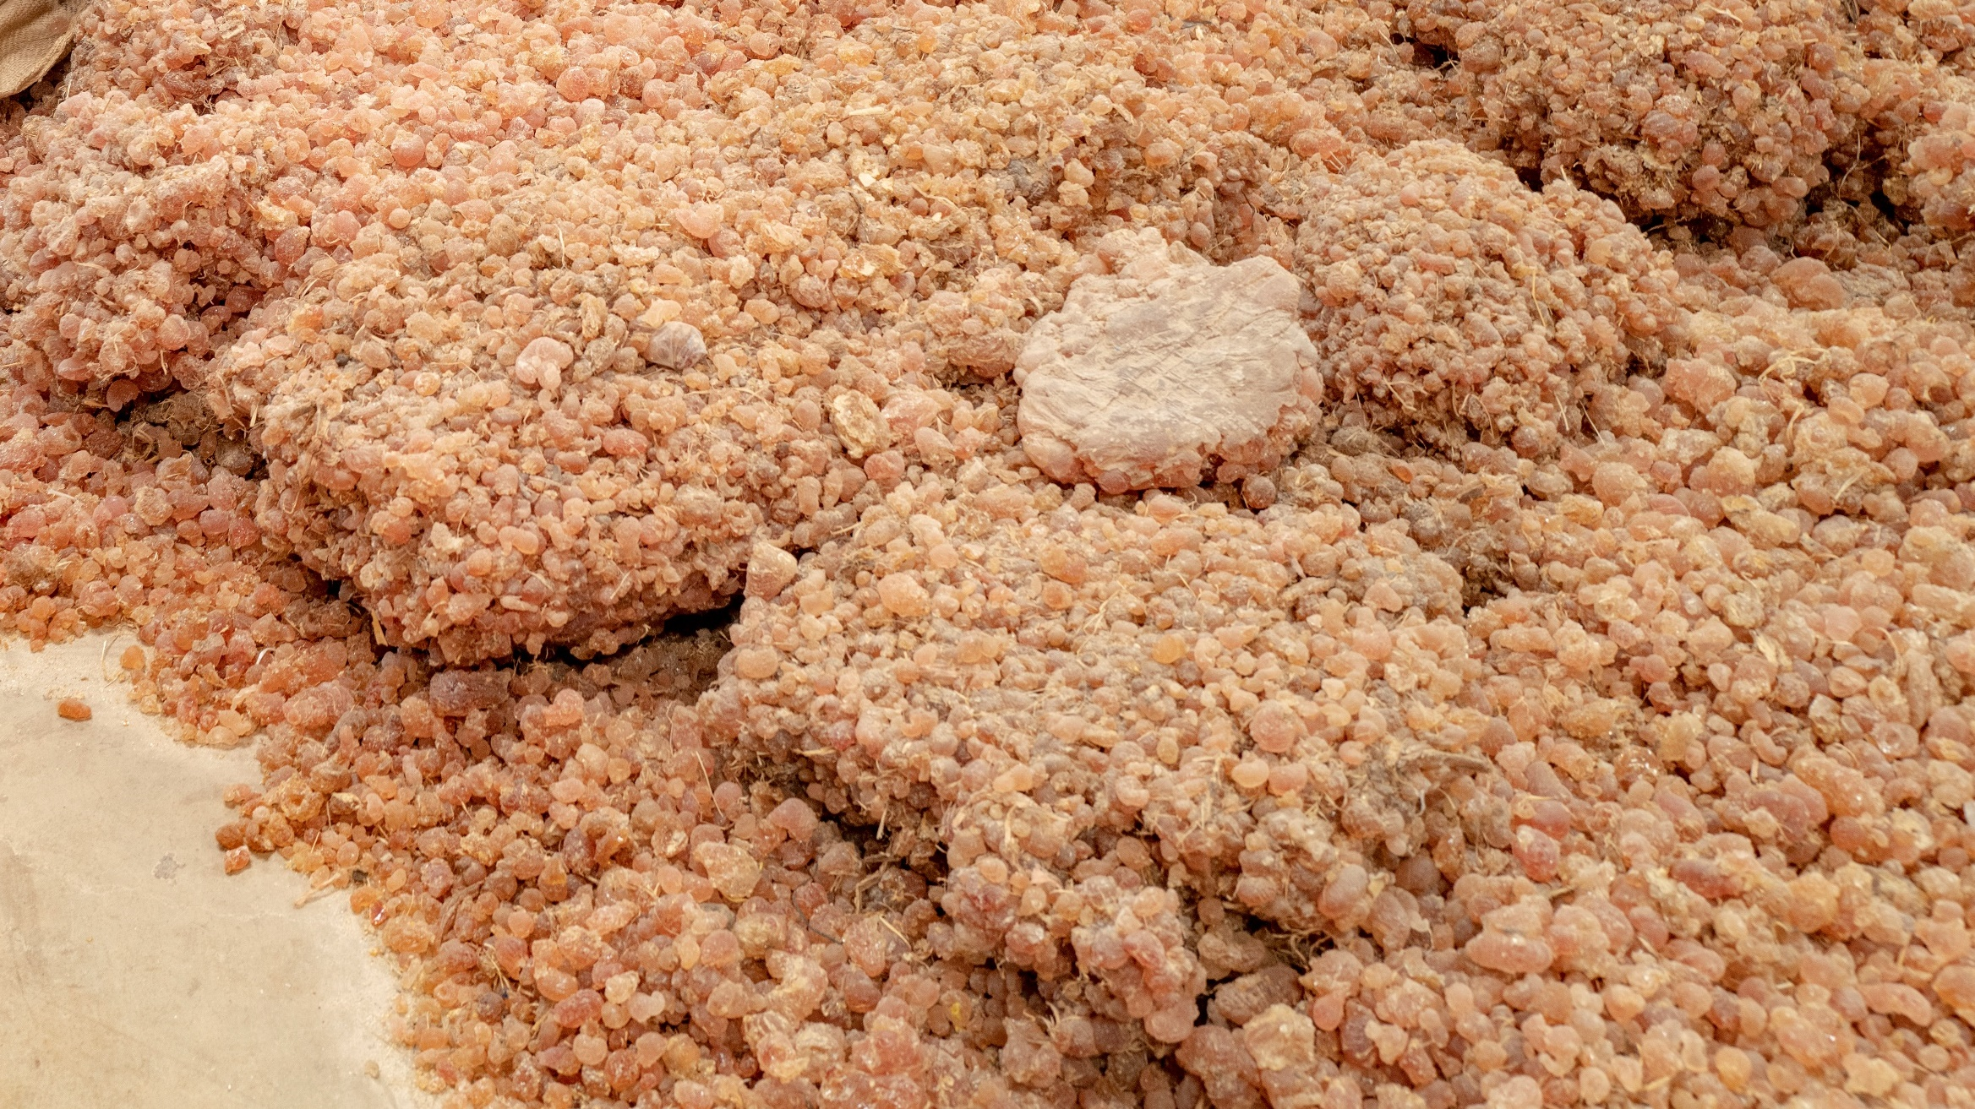
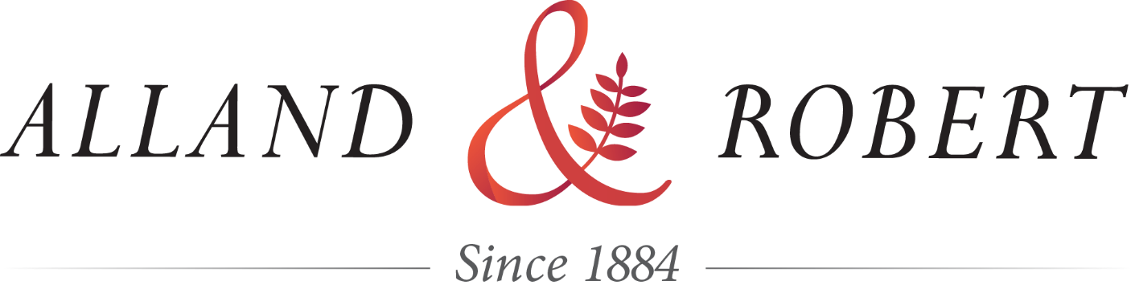
Corporate presentation

Slide 2

AGENDA
1
THE COMPANY
2. SOURCING ACACIA GUM
3. WHAT IS ACACIA GUM?
4. APPLICATIONS

Slide 3
AGENDA
1.
THE COMPANY

Slide 4
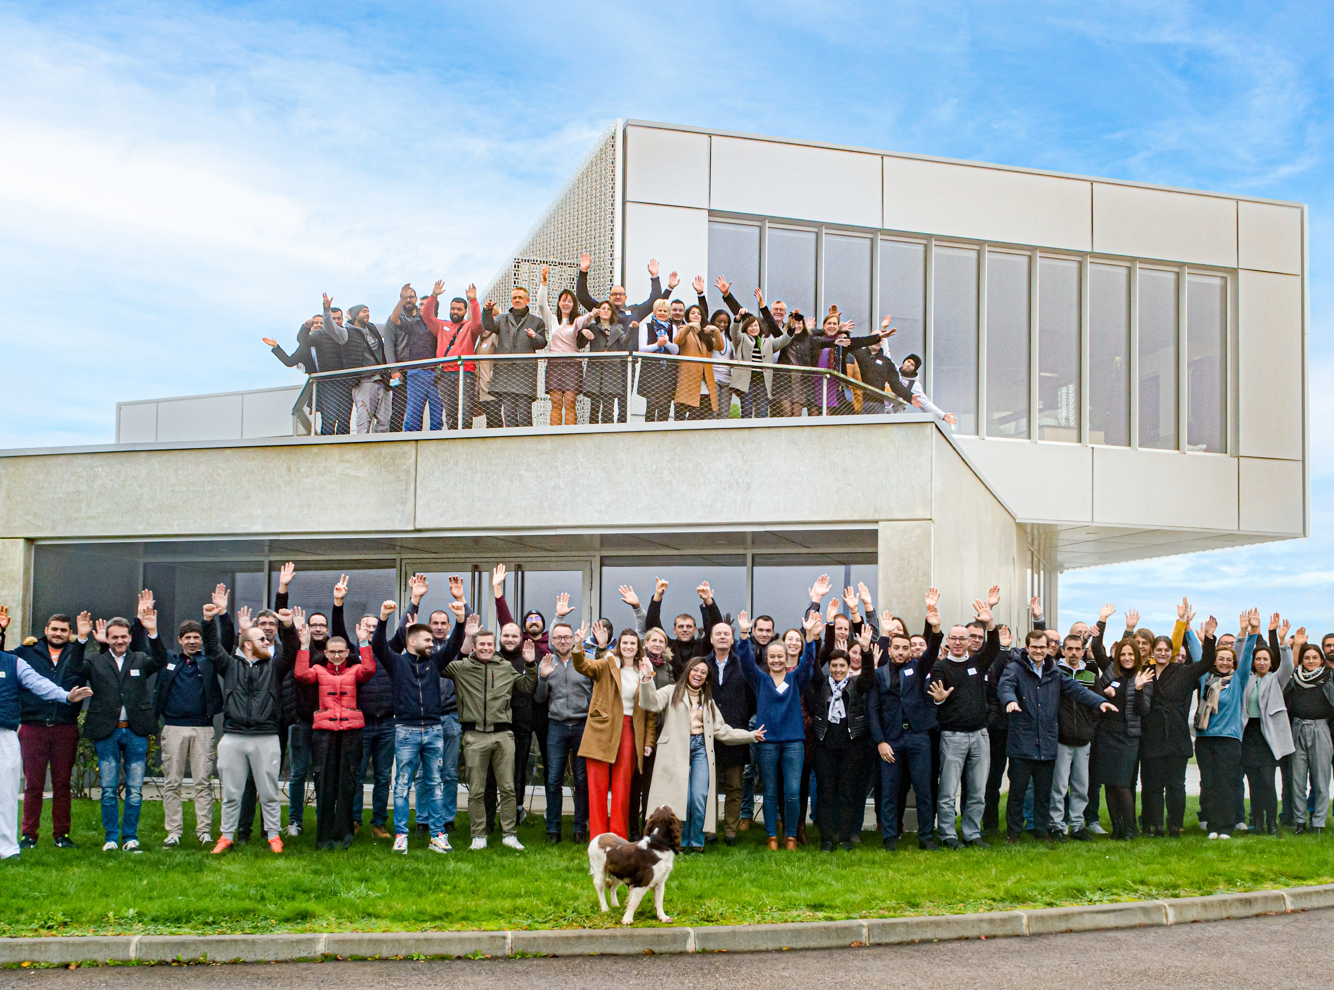
KEY FIGURES
1884
Foundation
of the company
Generation
family company
6TH
77
Millions €
revenue 2025

Slide 5
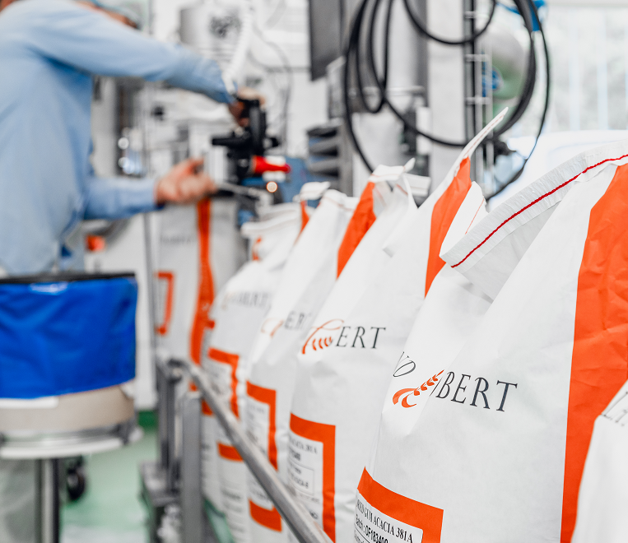
KEY FIGURES
Years
of experience
in natural gums
142
Countries
Alland & Robert sells to
70
Dedicated from
the very start
to natural gums
100%

Slide 6
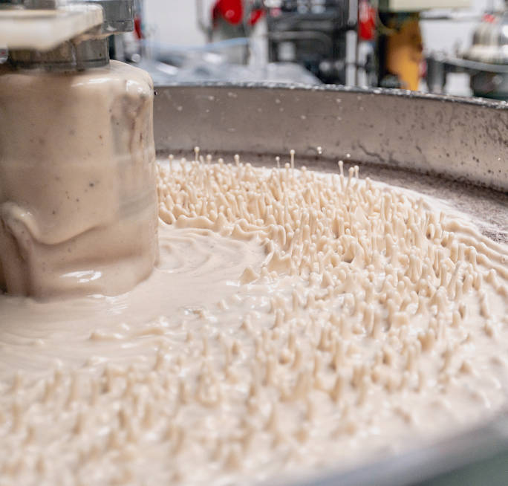


KEY FIGURES
3
5
130
Factories
Spray drying
towers
Employees
in 2025
32,000 t
+
2,500 t
1,000 t
95%
Capacity
of acacia gum
2025
Capacity
of karaya gum
Export
Manufactured
in France & India

Slide 7
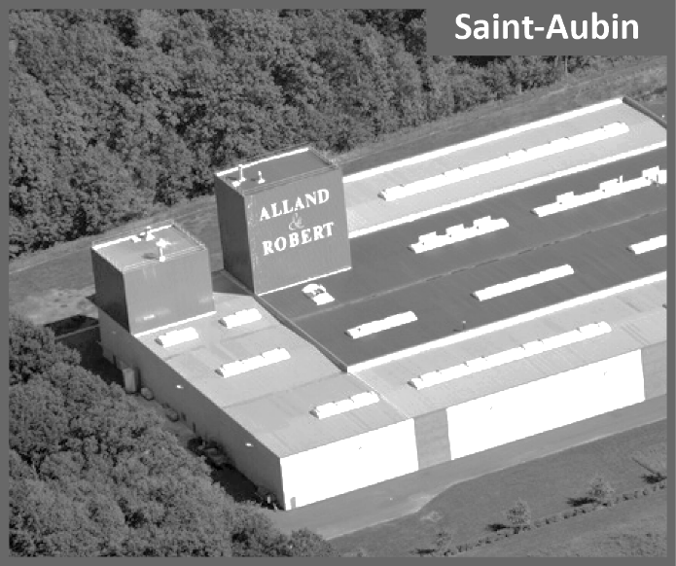


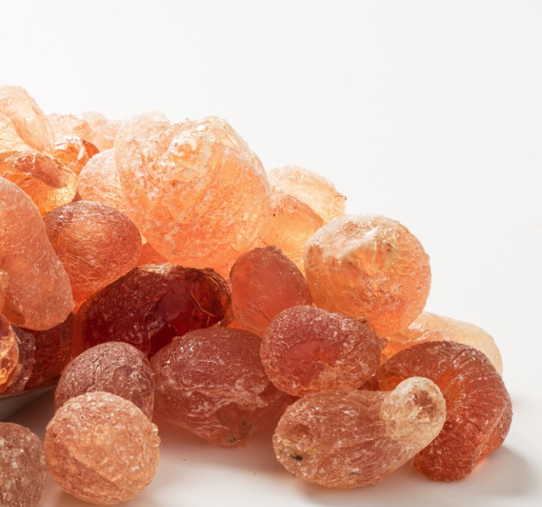
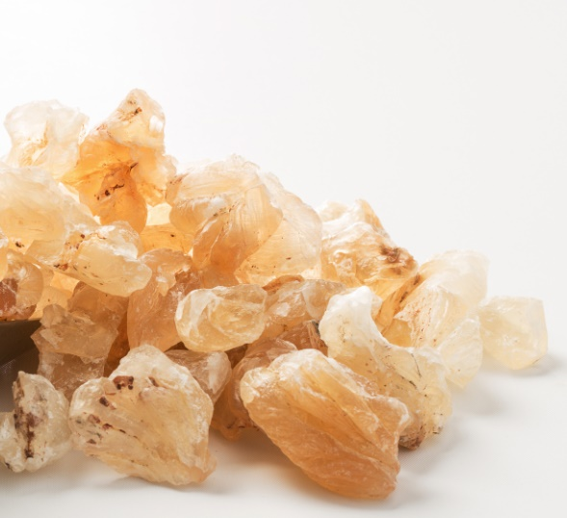



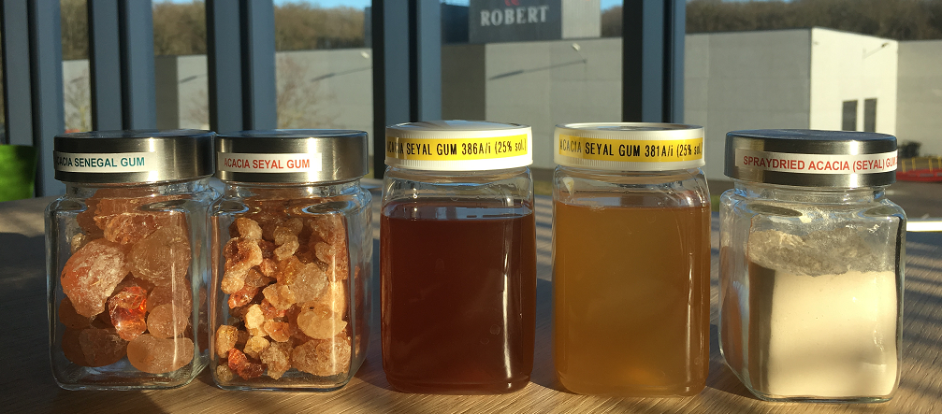

A GLOBAL EXPERT OF NATURAL PLANT EXUDATES
OUR MAIN NATURAL GUMS
Karaya Gum
SAINT AUBAN
PORT-MORT
PARIS
Coming from Acacia trees
Coming from Sterculia trees
For food, pharmaceutical, cosmetic, technical applications
For pharmaceutical, food applications
PARIS

Slide 8
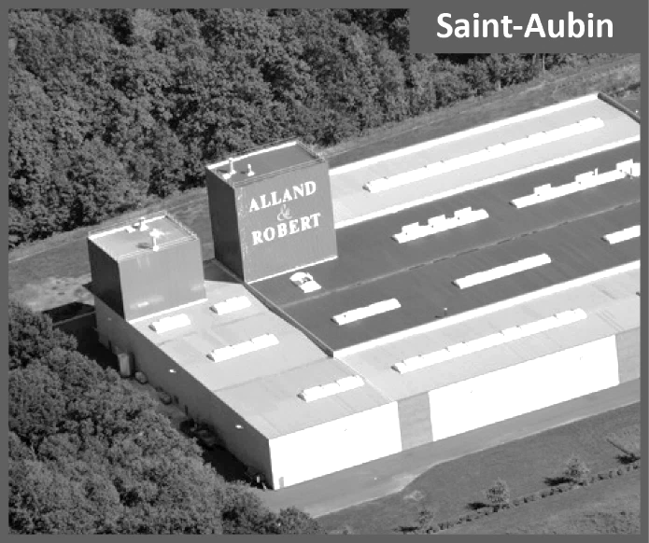
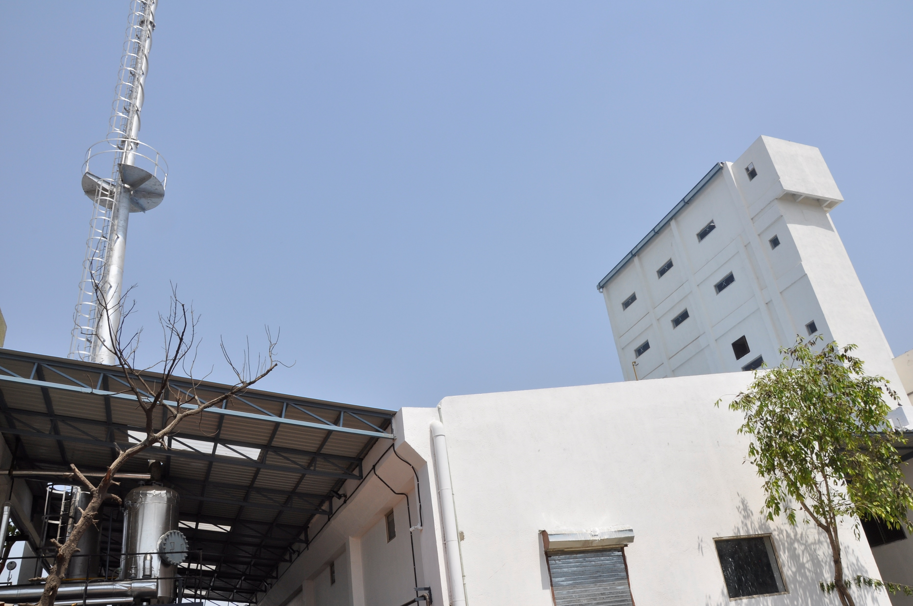
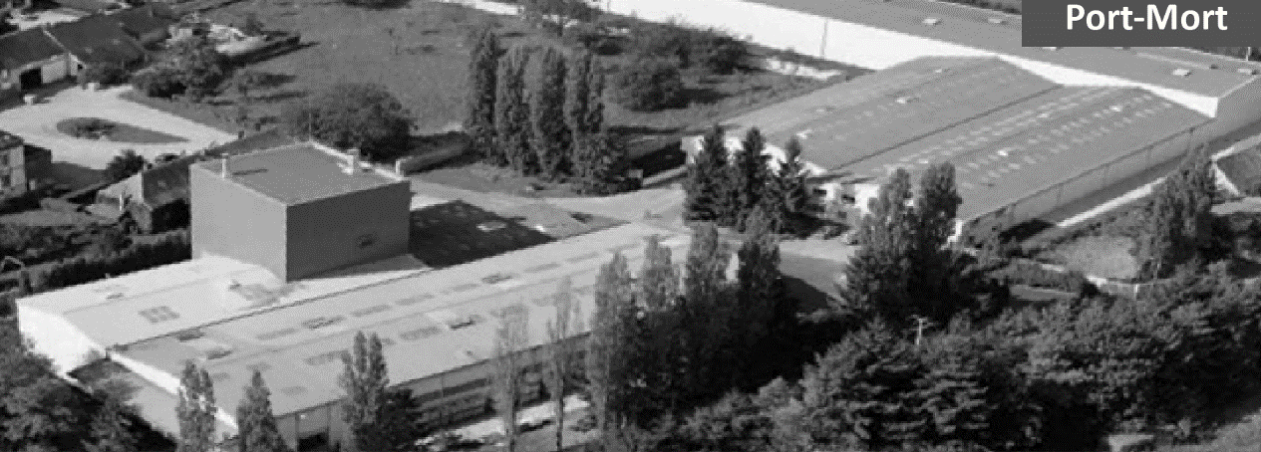
OUR MAIN NATURAL GUMS
4 LOCATIONS
Karaya Gum
PARIS
SAINT AUBIN
Administrative
Sales
Management
SAINT AUBIN
PORT-MORT
PARIS
AHMEDABAD
PORT-MORT
AHMEDABAD

Slide 9
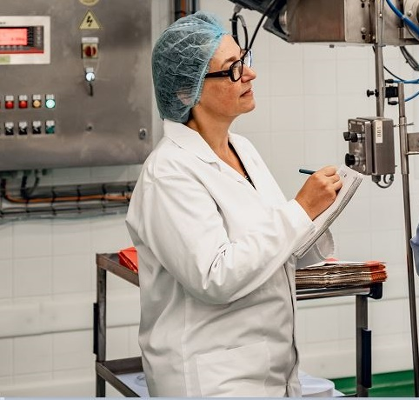
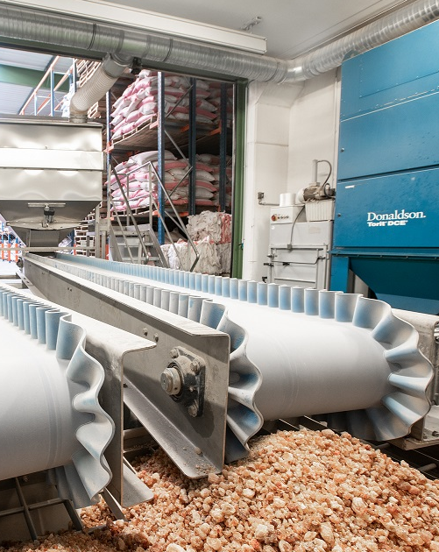



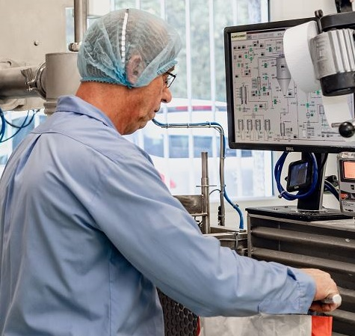
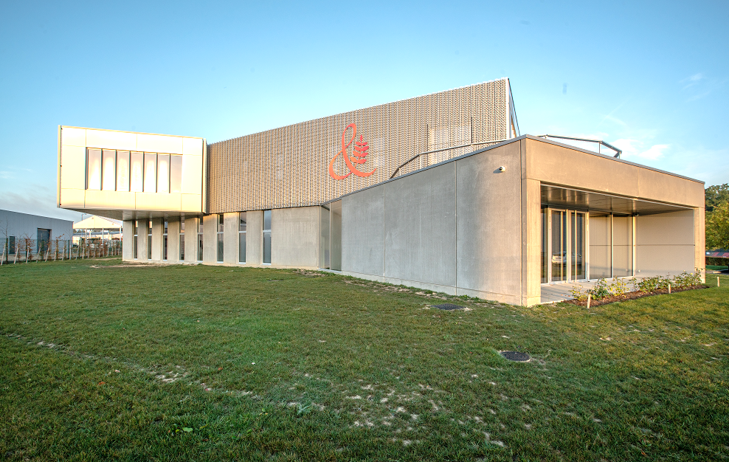
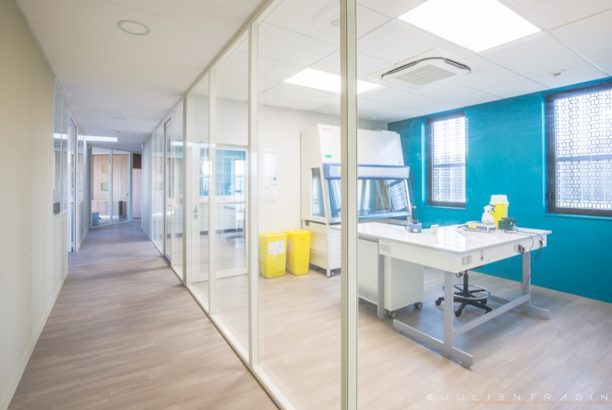

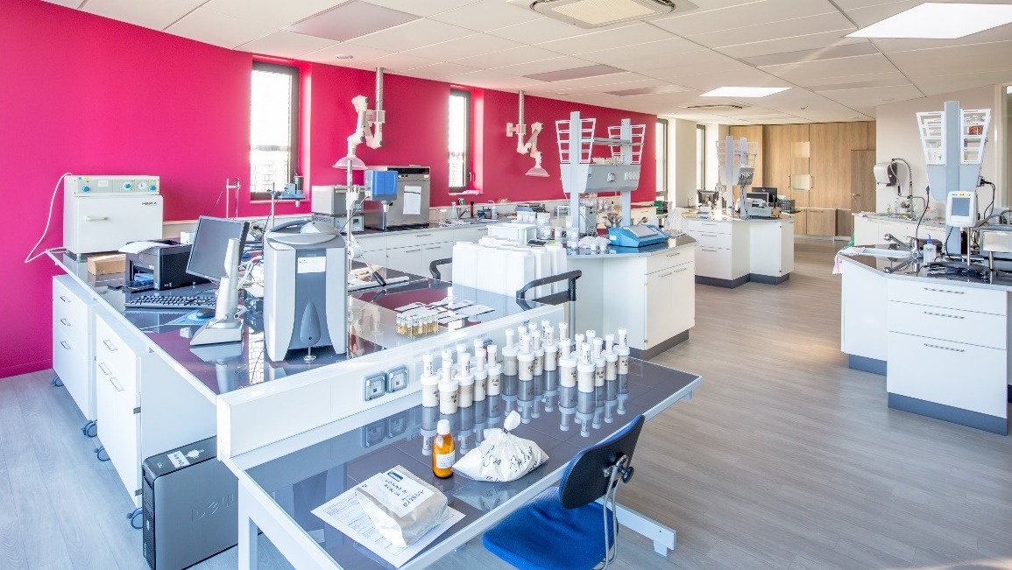
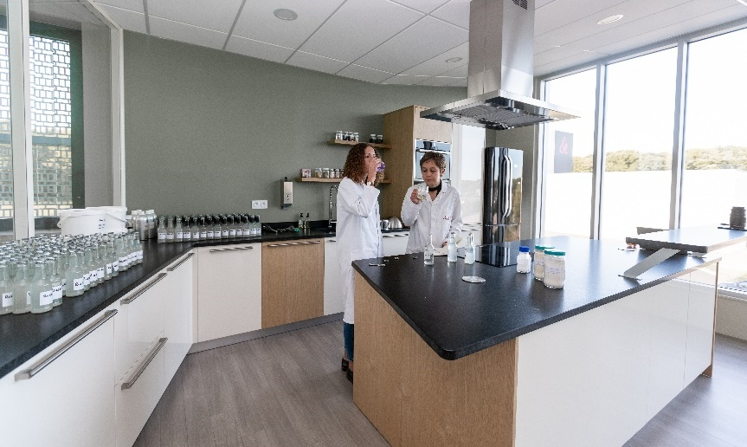
SINCE 2018
FOOD SAFETY
PHARMACEUTICAL
SAFETY
QUALITY SYSTEM
CERTIFICATIONS
ANSM
ISO 9001
BRC 9
H.A.C.C.P
Ensure that Alland & Robert can supply both excipients and active ingredients
to pharmaceutical
companies
Ensure that
Alland & Robert meet
the needs of customers and other stakeholders while meeting statutory and regulatory requirements
To certify quality
and safety, and protect
the end consumer

Slide 10
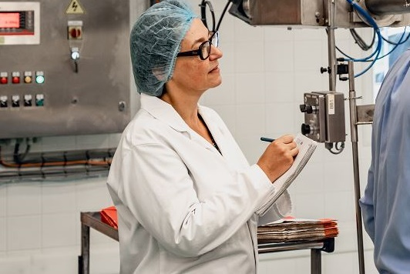





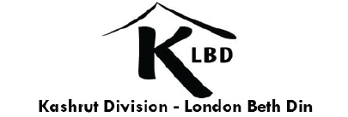


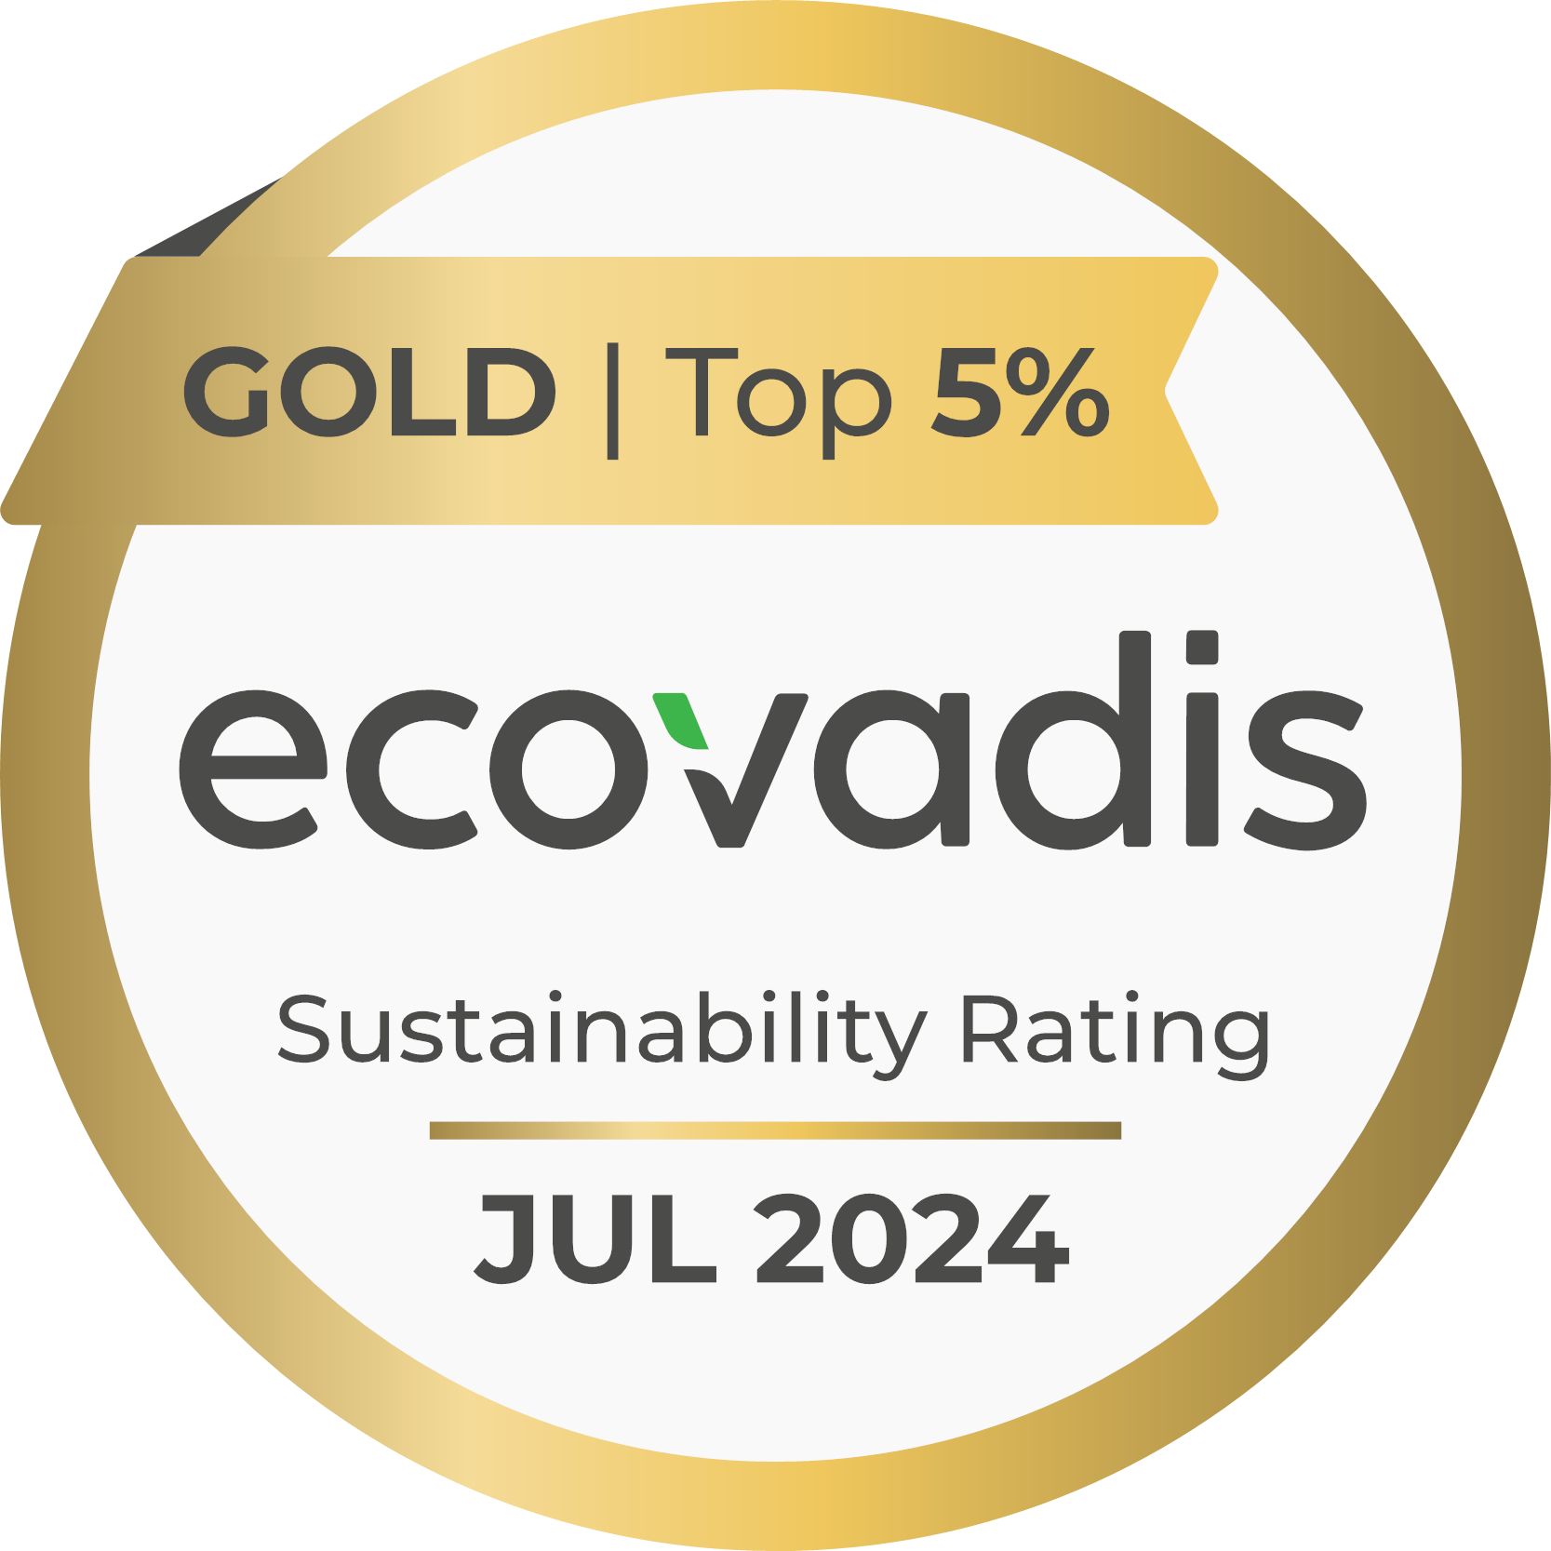




SOCIAL AND SOCIETAL
COMMITMENT
OTHER
CERTIFICATIONS
QUALITY SYSTEM
CERTIFICATIONS
SMETA REFERENTIAL
4 PILLARS:
Labor standards
Health & safety
Environment
Business ethics
ISO 9001
Organic
Ensure that Alland & Robert meet the needs
of customers and other stakeholders while meeting statutory and regulatory requirements..
Kosher & Halal
non-GMO Project
FODMAP FRIENDLY

Slide 11


SINCE 2018
SINCE 2024
New R&D offices with a technological & collaborative platform
Initiate, support and follow various projects in countries where Alland & Robert operates and in Africa.
Make a difference within
the communities where
Alland & Robert sources natural gums with a focus on environment & biodiversity preservation.
Custom-designed support for your innovation projects

Slide 12

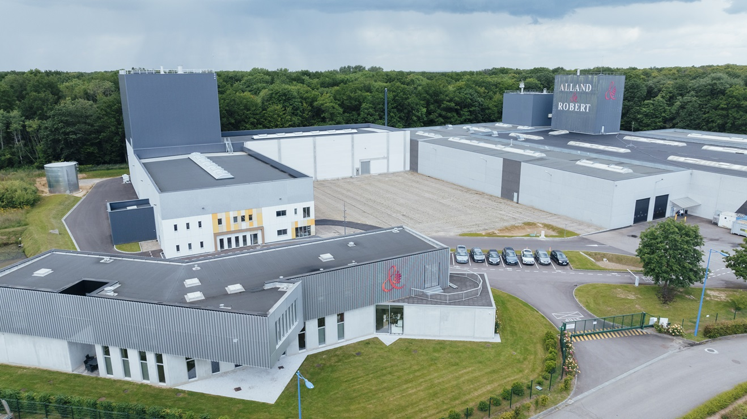

OUR MAIN NATURAL GUMS
NEW PRODUCTION AREA
SAINT AUBIN
10,000 m²
Production capacity :
+50% /year
32,000 t
+
2,500 t
Capacity
acacia gum
2025
laboratories
offices

Slide 13


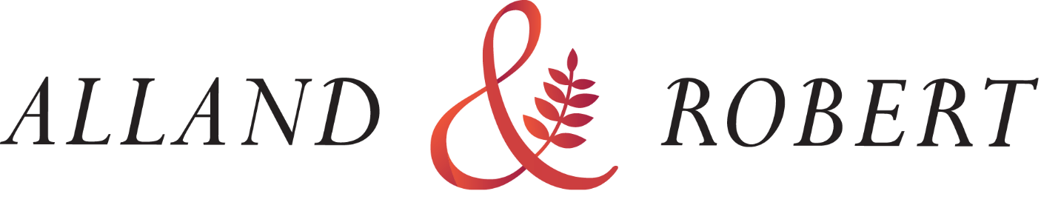

2021
ENVIRONMENTAL TRANSITION
&
ARE COMMITTED TO SUSTAINABILITY & CLIMATE ACTION
We work to decrease our carbon footprint
We use only natural and vegetal raw materials
We provide transparency of practices and ethics in our industry

Slide 14
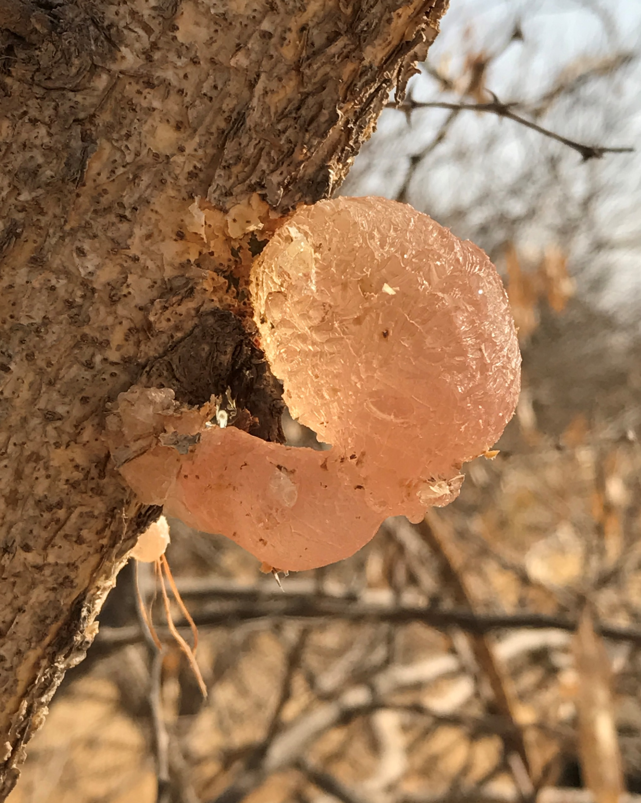
2.
SOURCING ACACIA GUM

Slide 15
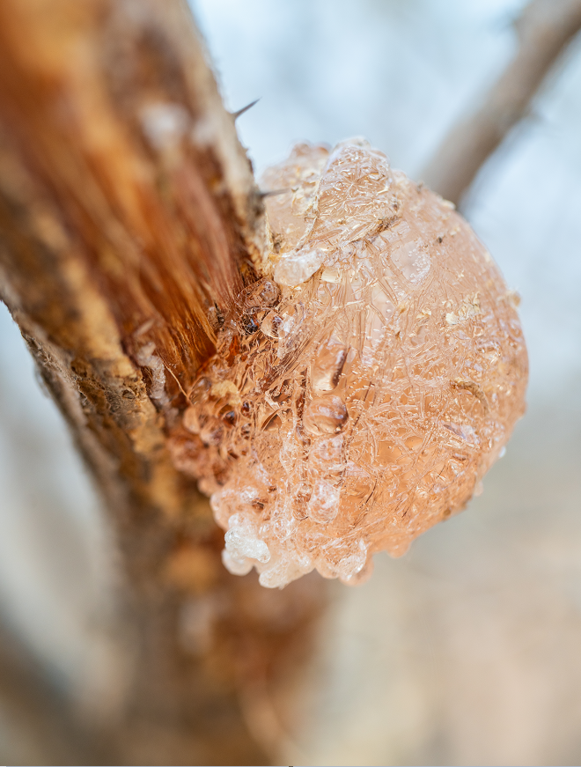
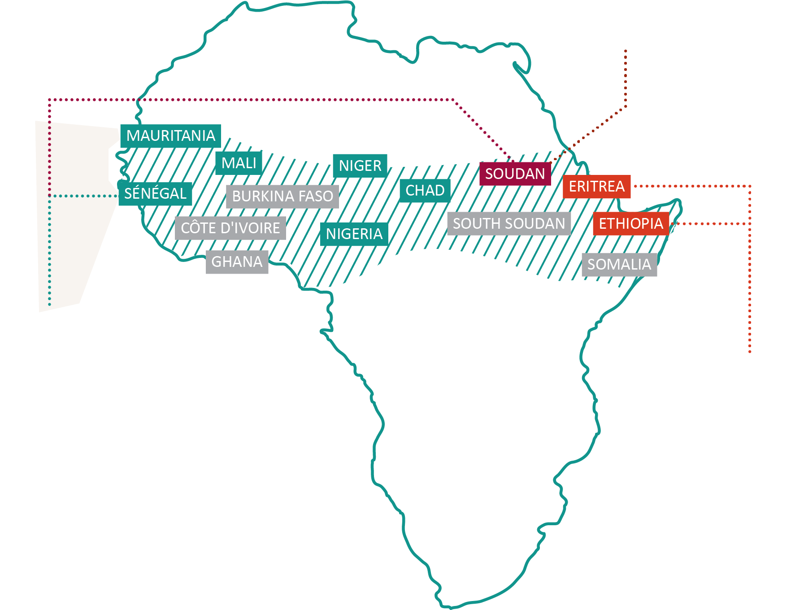

sourced sustainably directly from nature !
MAIN PRODUCING COUNTRIES
1st producing
country
PORT SUDAN
SUDAN
SENEGAL
DAKAR
IVORY COAST
NIGERIA
SOUTH SUDAN
PLANTATIONS
DOUALA
New opportunities
for acacia gum
World
production
75 000 MT /year

Slide 16

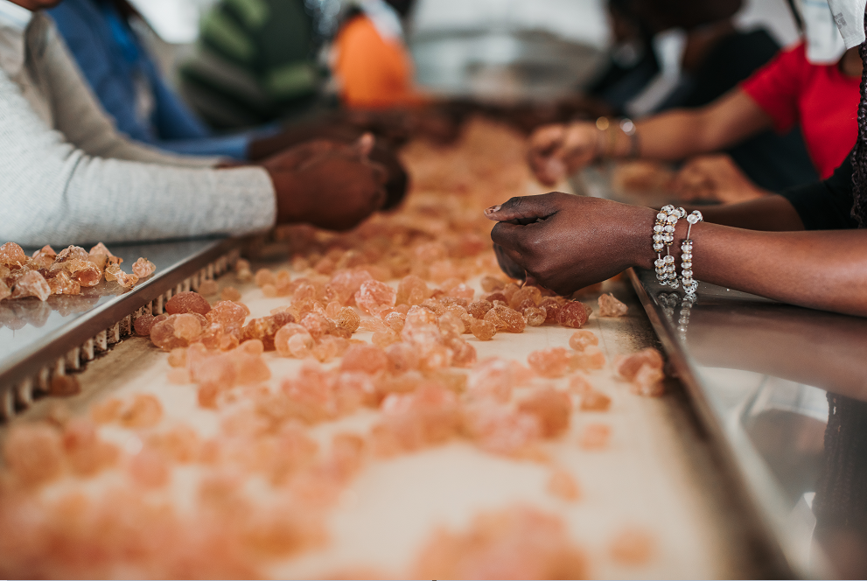
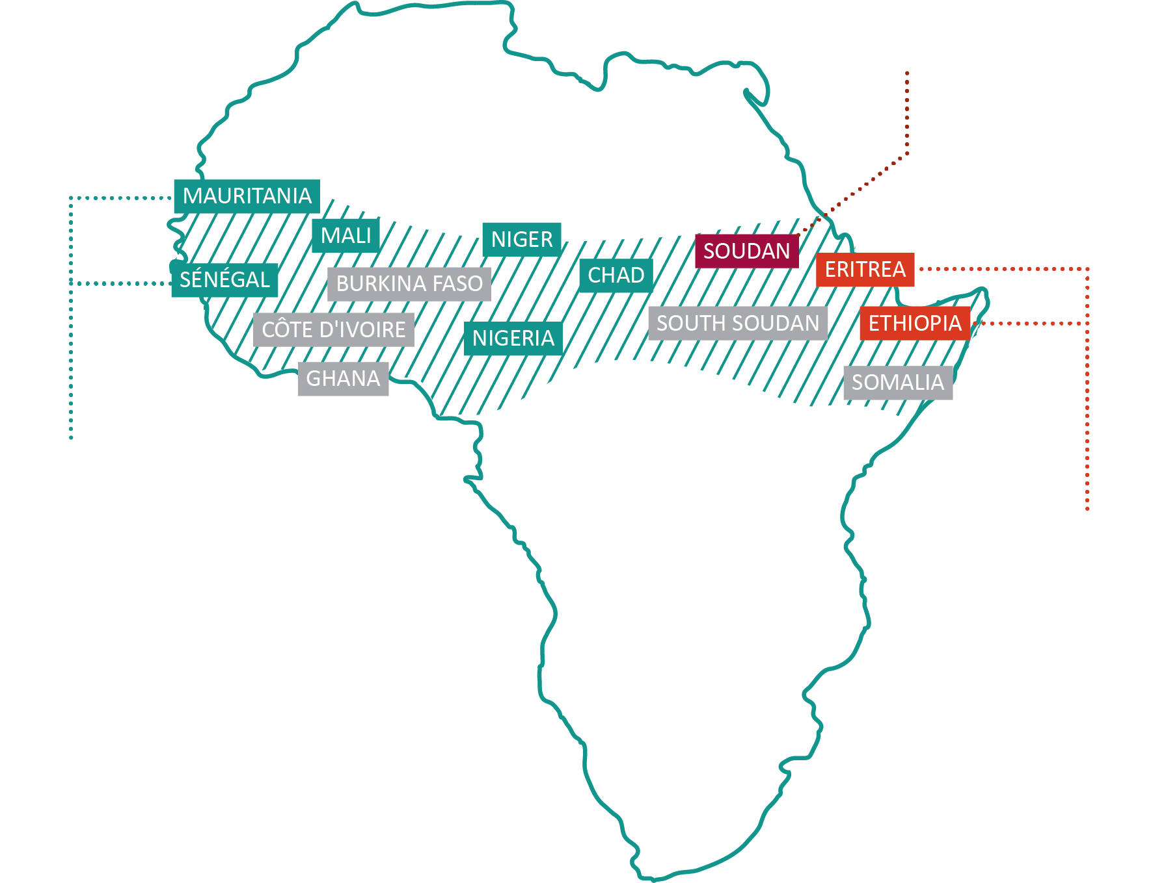






A Natural resourcE
sourced sustainably directly from nature !
HAND MADE
HARVEST IN THE
GUM BELT
PROVIDE REVENUES
TO LOCAL
POPULATIONS
PREVENT
DESERTIFICATION
SUDAN
SENEGAL
SOUTH SUDAN
USED BY MEN AS
A FOOD RESOURCE
FOR MILLENNIA
TREE FRIENDLY
HARVEST
LOW CARBON
PROCESS
IN THE WHOLE
PRODUCTION CHAIN

Slide 17
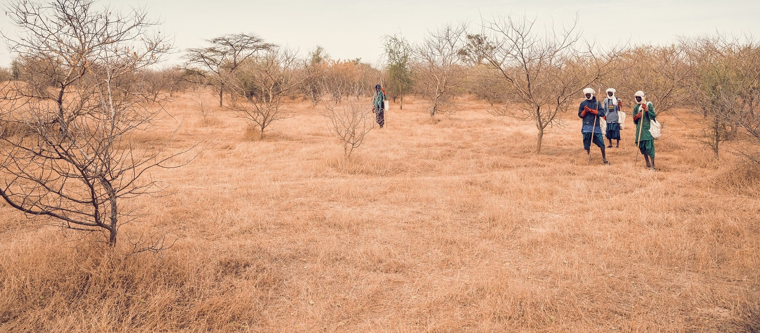




MAIN PRODUCING COUNTRIES
ALLAND & ROBERT
WORKS WITH RAW MATERIAL SUPPLIERS
1st producing
country
SUDAN
SENEGAL
SOUTH SUDAN
1
2
3
4
5
PLANTATIONS
New opportunities
for acacia gum
Helping the development of the local acacia gum industry
in Africa
Kibbling and sorting installations in Senegal, Chad and Mali
- Working with all stakeholders to share information
- Fair trade relations
Working with suppliers
to improve harversting and selection of crude gum and ensure safety
of supplies
Yearly audits
to our suppliers, including safety, ethical, environmental and societal standards
- Technical assistance
to our providers
- Transparent and honest relationships
- Installation of warehouses
in Senegal, Chad and Mali
- Offering Fair Price

Slide 18
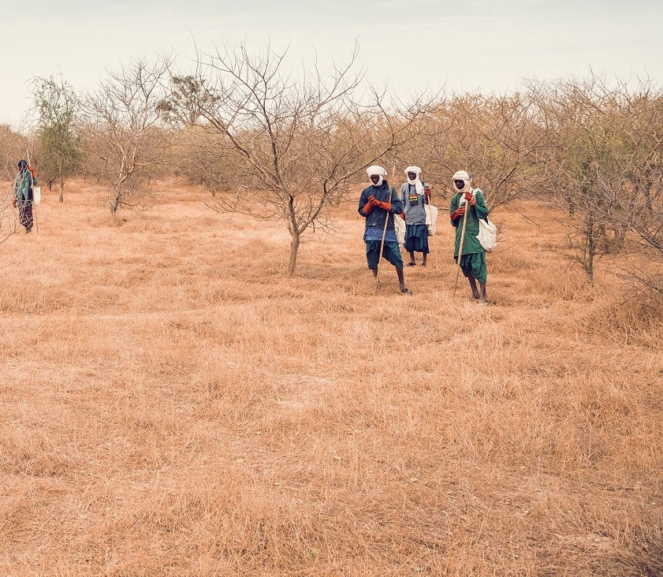



ALLAND & ROBERT
WORKS TO PREVENT DEFORESTATION
“Let’s plant trees
together!”
100%
NO
VEGETAL, GLUTEN FREE
AND ALLERGEN FREE
CHEMICALS
PESTICIDES
GMOs
PRESERVATIVE
Support the reforestation
of acacias and other trees in their native environment
Use acacias unique properties to tackle desertification and climate change
Since 2020,
an innovative
campaign to…
FULL TRACEABILITY
THROUGH ORGANIC
CERTIFICATION
Create
land restoration
and climate resilience
in the Sahel
Support communities and protect their environment where
we source natural gums
4
5
- Fair trade relations
Yearly audits
to our suppliers, including safety, ethical, environmental and societal standards
- Transparent and honest relationships
- Offering Fair Price

Slide 19

ALLAND & ROBERT
ENSURES THE HIGHEST QUALITY OF RAW MATERIAL
For more on our supply chain,
see our video:
“Let’s plant trees
together!”
100%
NO
VEGETAL, GLUTEN FREE
AND ALLERGEN FREE
CHEMICALS
PESTICIDES
GMOs
PRESERVATIVE
FULL TRACEABILITY
THROUGH ORGANIC
CERTIFICATION
Since 2020,
an innovative
campaign to…

Slide 20
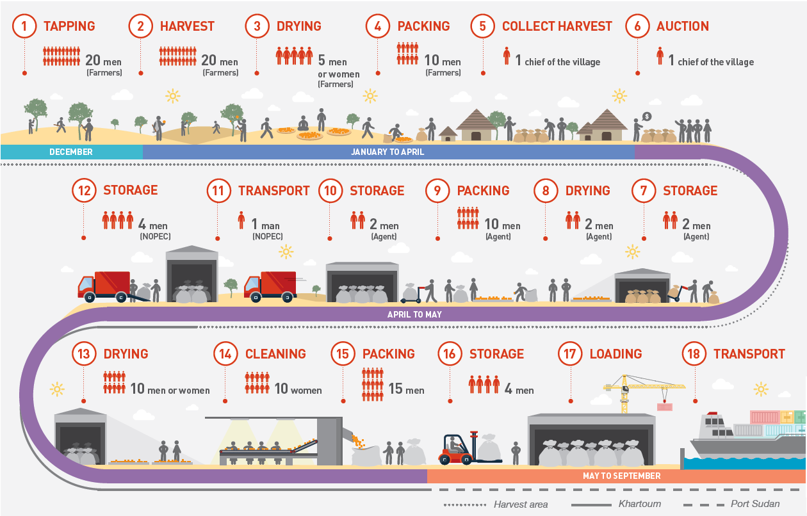
ALLAND & ROBERT
1
For more on our supply chain,
see our video:

Slide 21
3.
WHAT IS ACACIA GUM?

Slide 22
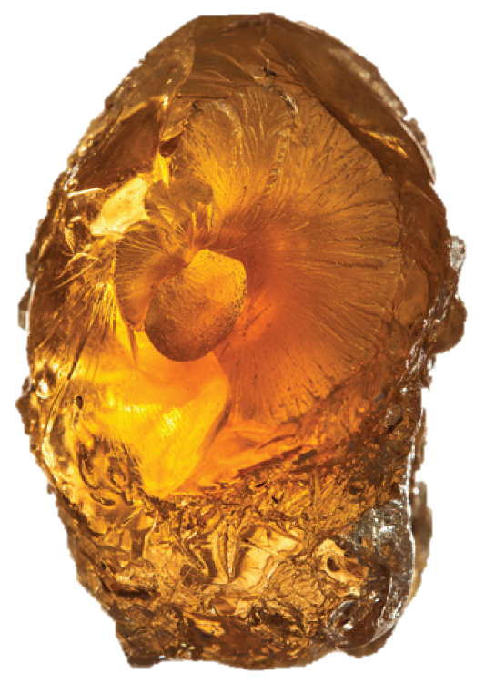
DIFFERENCES
IN FUNCTIONAL
PROPERTIES
1.
HIGH SAFETY
INGREDIENT
4.
ODOURLESS, TASTELESS,
COLOURLESS
E414
2.
MULTI-FUNCTIONAL
POLYSACCHARIDE
5.
HIGHLY SOLUBLE
IN WATER
Rhamnose, Galactose, Arabinose, Glucuronic acids
3.
VEGETAL, NATURAL,
GMO FREE
6.
LOW CALORIFIC
VALUE

Slide 23
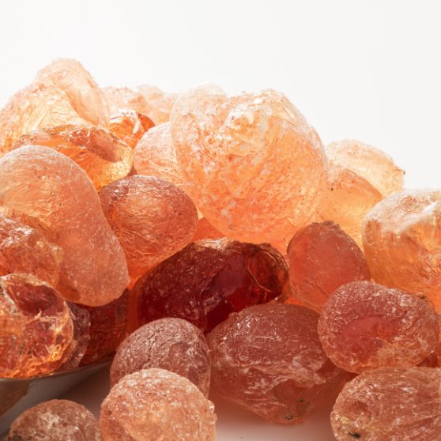
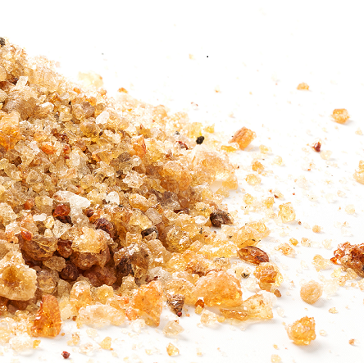
1.
4.
HIGH SAFETY
INGREDIENT
ODOURLESS, TASTELESS,
COLOURLESS
SENEGAL GUM
SEYAL GUM
E414
DIFFERENCES
IN FUNCTIONAL
PROPERTIES
PROTEIN CONTENT
PROTEIN CONTENT
2.
2%
1%
MULTI-FUNCTIONAL
POLYSACCHARIDE
5.
HIGHLY SOLUBLE
IN WATER
Rhamnose, Galactose, Arabinose, Glucuronic acids
Laevorotatory optical
rotation
Dextrorotatory optical
rotation
-20 to -35°
+35 to +60°
3.
6.
VEGETAL, NATURAL,
GMO FREE
LOW CALORIFIC
VALUE

Slide 24
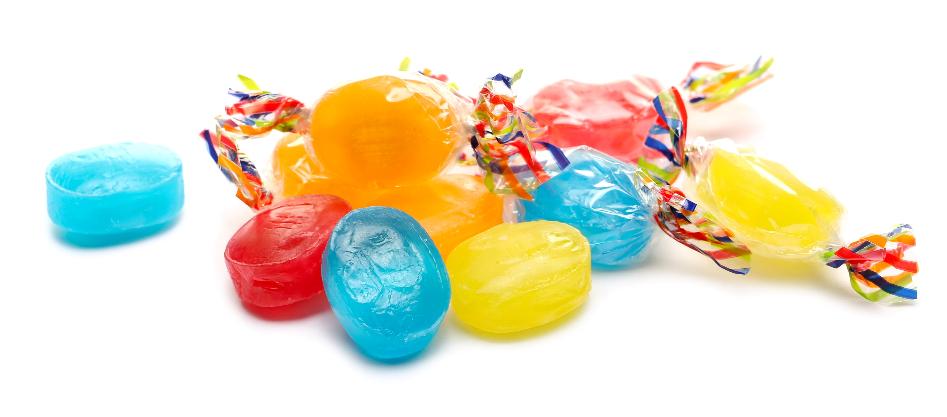
ALLAND & ROBERT
FUNCTIONAL PROPERTIES
OF ACACIA SENEGAL AND SEYAL
Texturing
Agent
Influence on
the viscosity,
body, texture
and behavior
of the products

Slide 25
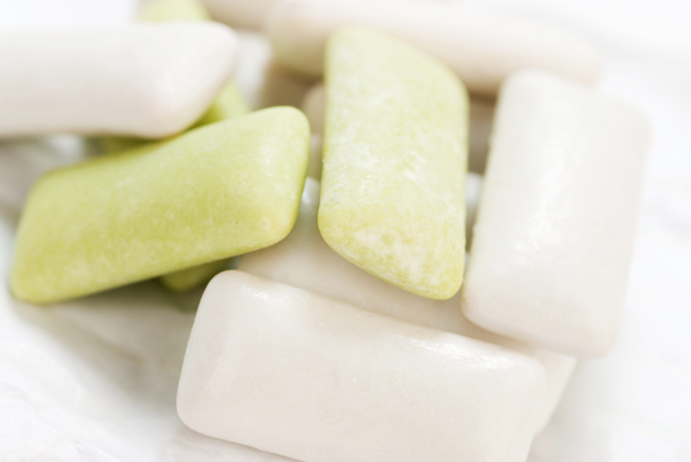

ALLAND & ROBERT
FUNCTIONAL PROPERTIES
OF ACACIA SENEGAL AND SEYAL
Film
Forming
Agent
Protection
against moisture
and migration

Slide 26
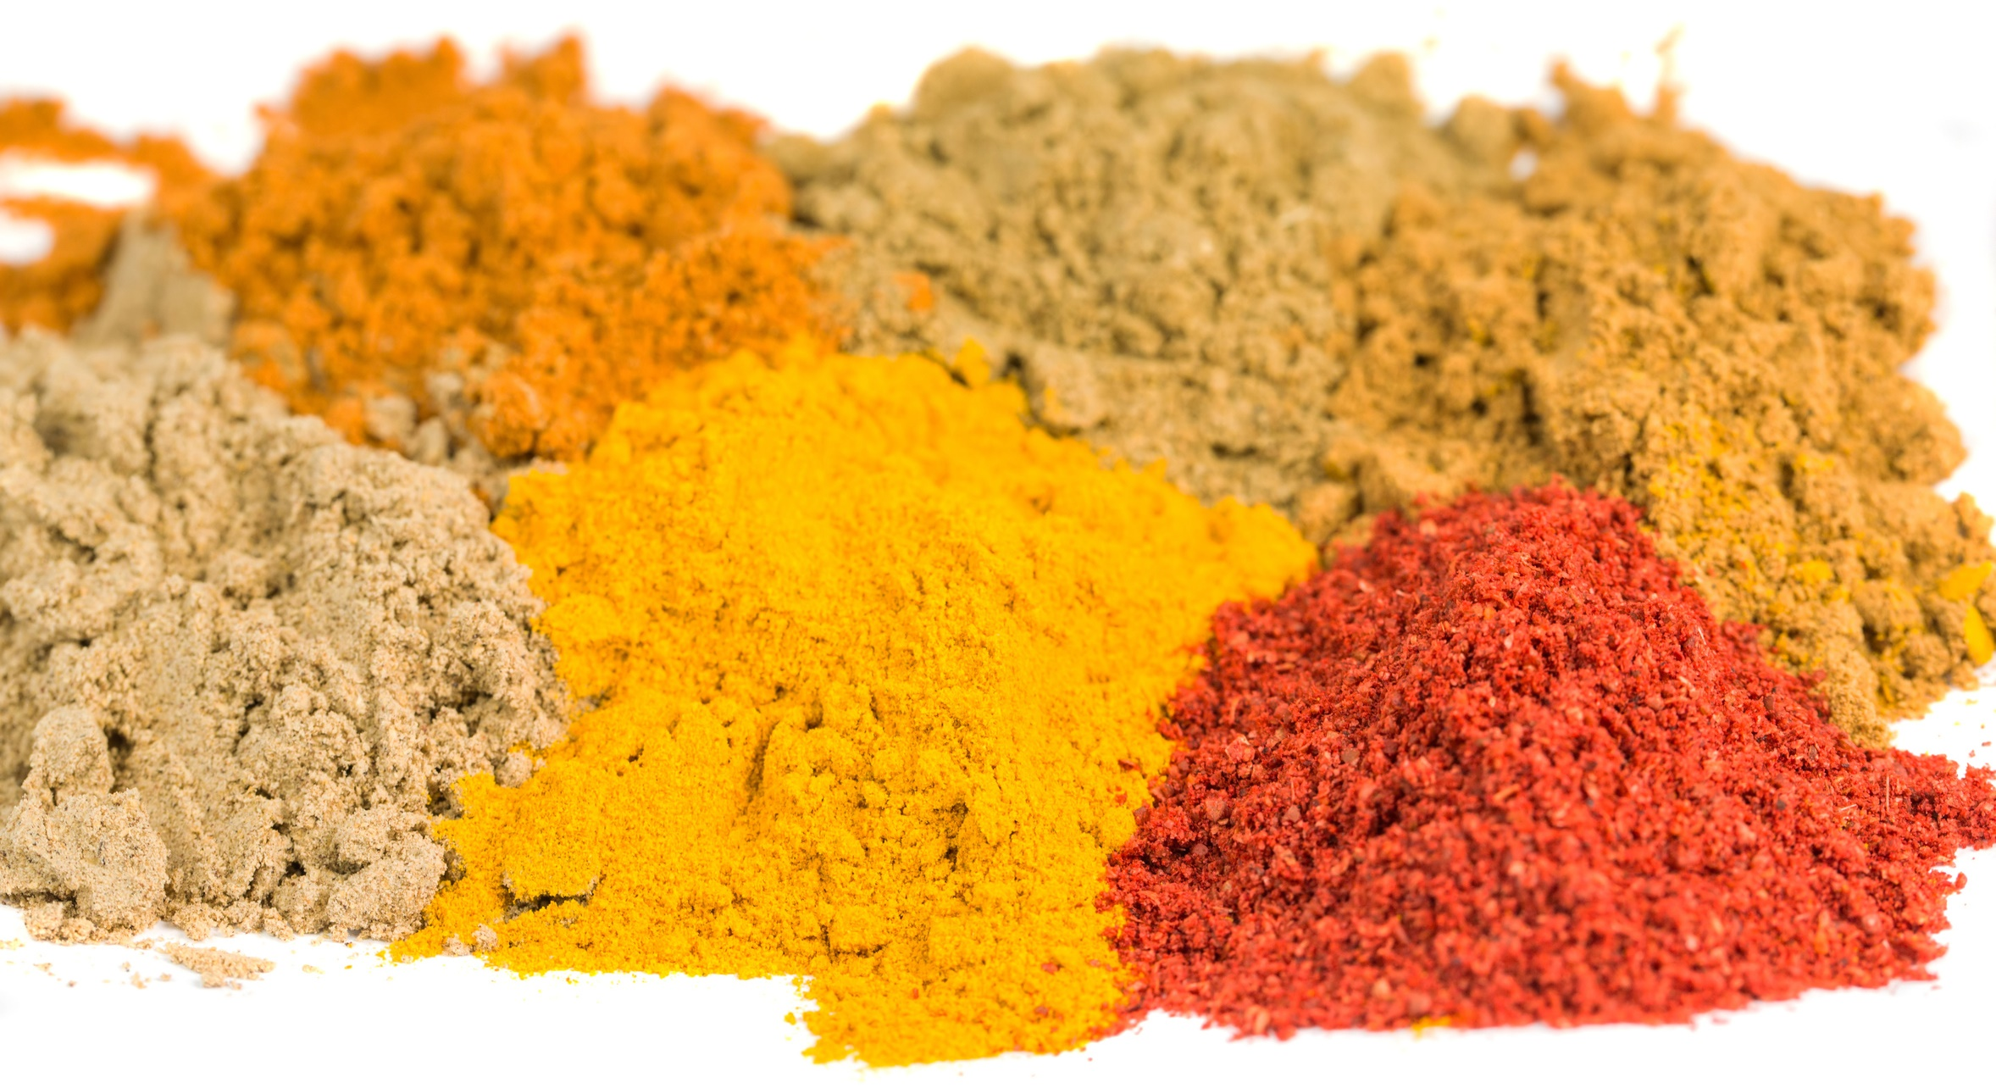

ALLAND & ROBERT
FUNCTIONAL PROPERTIES
OF ACACIA SENEGAL AND SEYAL
Bulking
agent
Used as a carrier
in dry mixes
for hydro-soluble
substances

Slide 27


ALLAND & ROBERT
FUNCTIONAL PROPERTIES
OF ACACIA SENEGAL AND SEYAL
High
Soluble
fiber
in dietary
applications
Increase of fiber
content in formulas

Slide 28


ALLAND & ROBERT
FUNCTIONAL PROPERTIES
OF ACACIA SENEGAL
Emulsifying
agent
Oil-in water
emulsions

Slide 29

ALLAND & ROBERT
FUNCTIONAL PROPERTIES
OF ACACIA SENEGAL
Avoids
crystallisation
of sucrose
Improves the quality
of confectioneries

Slide 30







ALLAND & ROBERT
FUNCTIONAL PROPERTIES
OF ACACIA SENEGAL AND SEYAL
Protects
color of wines
Colloidal protection
and improvement
of the mouthfeel
Mouthfeel
Improvement
Natural glue
Extrusion
Softening action
and longer taste
Safe and organic
food adhesive
Processing aid,
gustatory sensation
improver
Emulsion
Fiber
enrichment
Coating
Encapsulation
Emulsifying
properties
and stabilization
90% fiber content,
highly soluble
Film forming abilities,
perfect for gumming
operations
Flavor retention,
protection and use
as a carrier

Slide 31

ALLAND & ROBERT
FUNCTIONAL PROPERTIES
OF ACACIA SENEGAL AND SEYAL
Protects
color of wines
Texturing
Mouthfeel
Improvement
Natural glue
Extrusion
Better textures
and hardness
Softening action
and longer taste
Safe and organic
food adhesive
Processing aid,
gustatory sensation
improver
Colloidal protection
and improvement
of the mouth feel
Emulsion
Fiber
enrichment
Coating
Encapsulation
Emulsifying
properties
and stabilization
90% fiber content,
highly soluble
Film forming abilities,
perfect for gumming
operations
Flavor retention,
protection and use
as a carrier

Slide 32





FUNCTIONAL PROPERTIES
An ingredient in line
with today’s trends
More fiber,
less sugar
Clean & clear label
Vegetarian/
vegan diets
Healthy
& organic food
Ethic & sustainable food
Texturing
Mouthfeel
Improvement
Natural glue
Extrusion
Better textures
and hardness
Softening action
and longer taste
Safe and organic
food adhesive
Processing aid,
gustatory sensation
improver
Emulsion
Fiber
enrichment
Coating
Encapsulation
Emulsifying
properties
and stabilization
90% fiber content,
highly soluble
Film forming abilities,
perfect for gumming
operations
Flavor retention,
protection and use
as a carrier

Slide 33

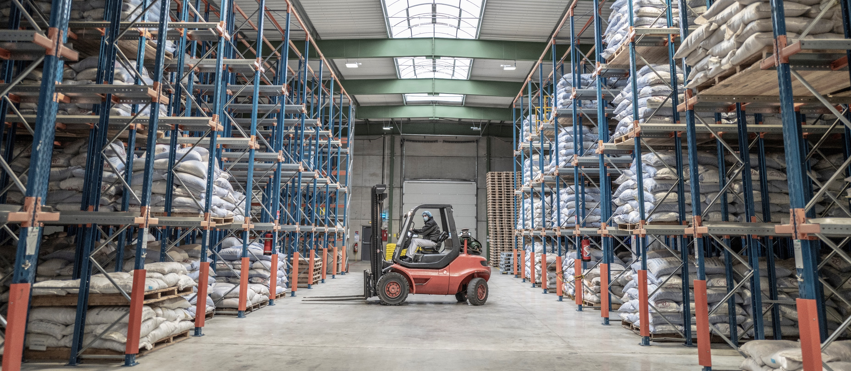





KEY FIGURES
CONCLUSION: WHAT WE STAND FOR
Karaya Gum
2
3
100
R&D Strong Expertise
International Certifications
Supplier Network
for Supply Safety
20,000t
350t
95%
Customized
Customer Service
Corporate
Responsibility
Integrated
Supply Chain
Coming from Acacia trees
Coming from Sterculia trees
For food, pharmaceutical, cosmetic, technical applications
Manufactured
In France
For pharmaceutical, food applications

Slide 34








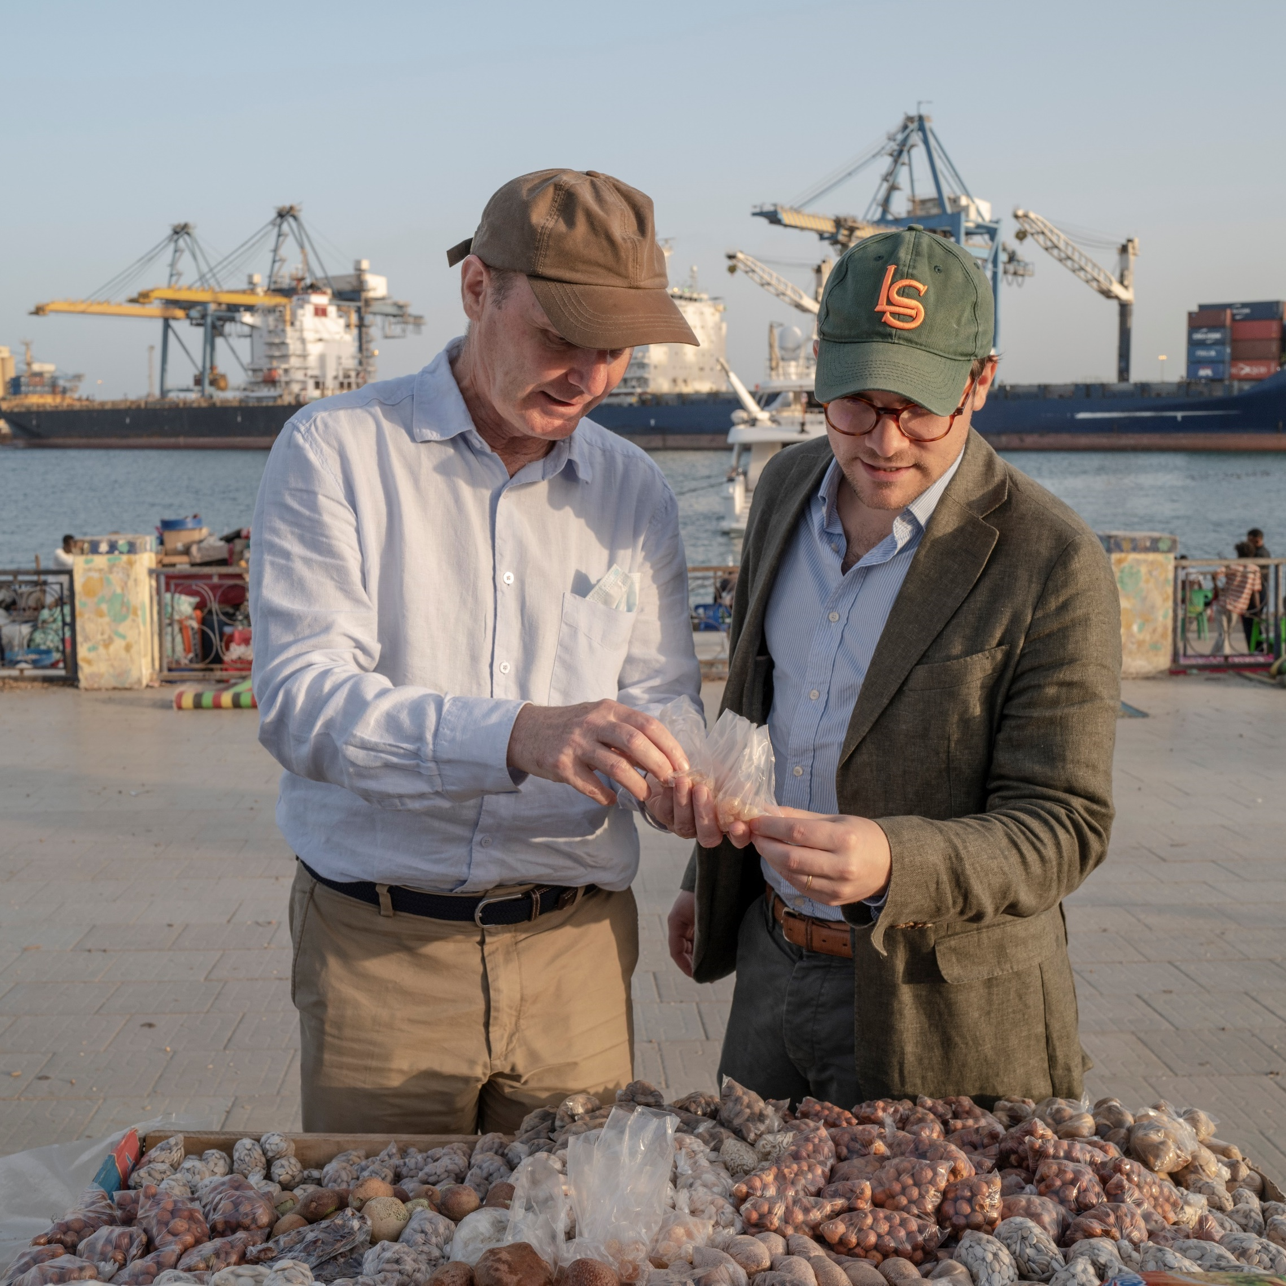
Conclusion
Follow us !
Thank you
for your
attention!
Alland & Robert
Alland&Robert
@allandrobert
www.allandrobert.com
A commitment to develop
the quality of products through sustainable development, social investment and environmental awareness.
Solid partnerships with our African suppliers and local investment in developing communities related
to GUM ACACIA.

