Slide 1


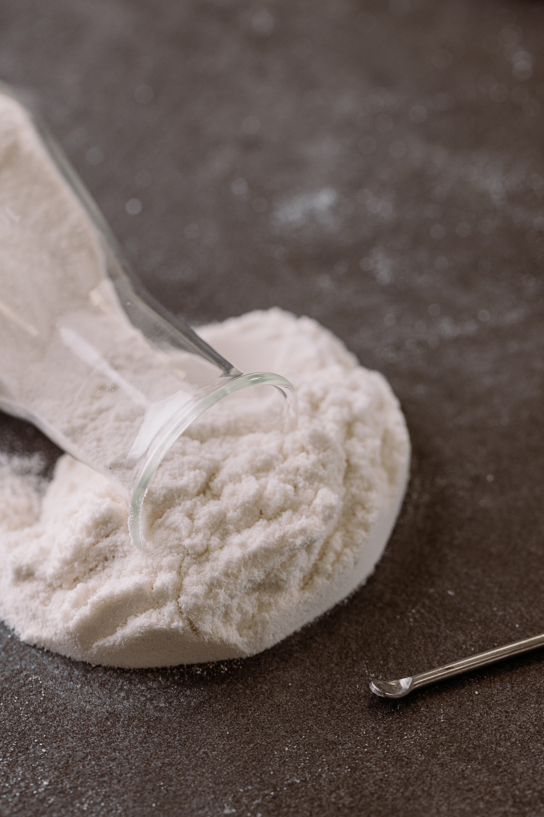




Slide 2


Agenda
1. About Alland & Robert
2. Acacia gum
3. Introducing Beyond Acacia
4. Technological excellence
5. Low carbon range

Slide 3

1.
About Alland & Robert

Slide 4
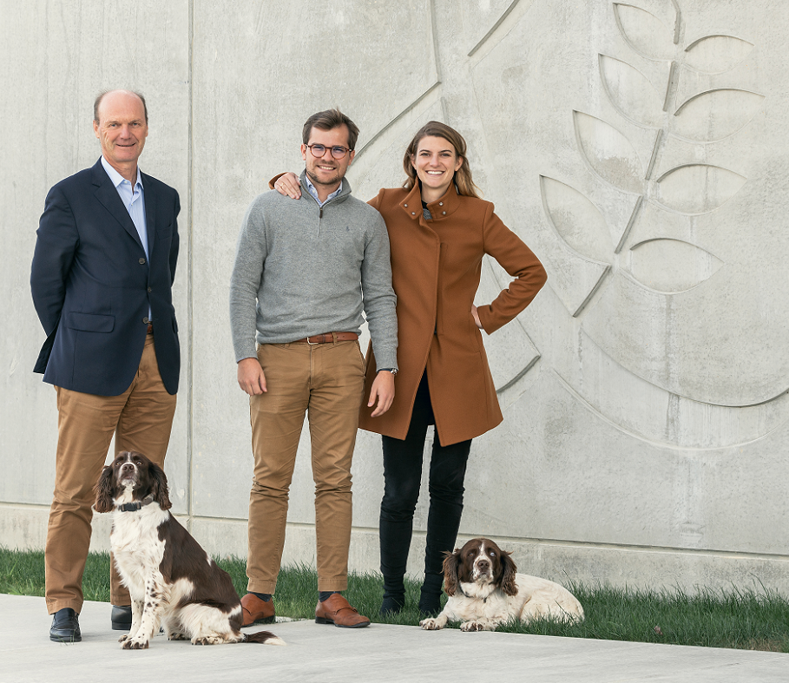

Key Figures
1884
Foundation
of the company
Generation
family company
6TH
68
Millions €
revenue 2022

Slide 5

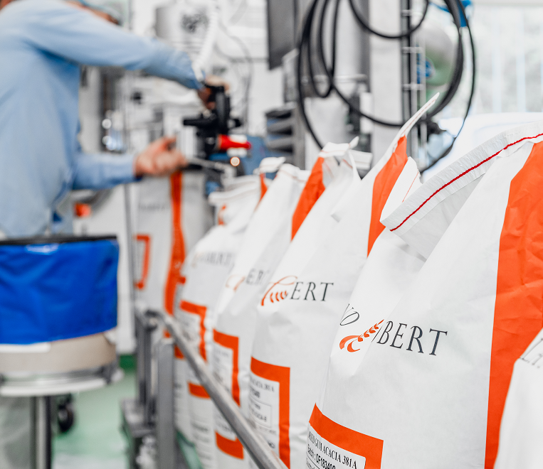

Key Figures
Years
of experience
in natural gums
139
Countries
Alland & Robert sells to
70
Dedicated from
the very start
to natural gums
100%

Slide 6

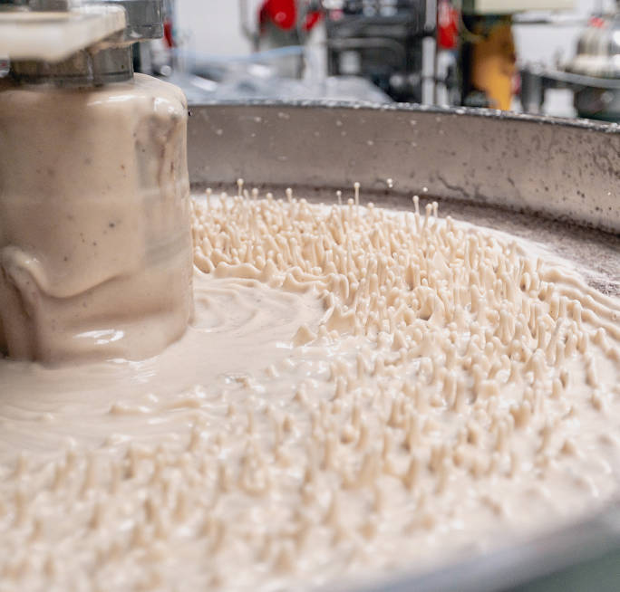


Key Figures
3
5
120
Factories
Spray drying
towers
Employees
in 2022
25,000 t
+
2,500 t
1,000 t
95%
Capacity
of acacia gum
2023
Capacity
of karaya gum
Export
Manufactured
in France & India

Slide 7

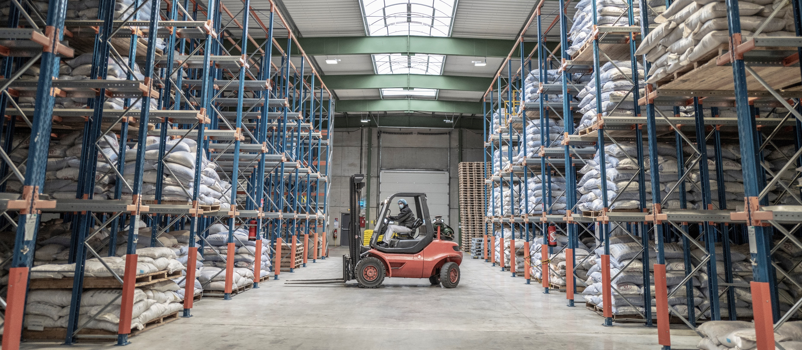





A global expert of natural plant exudates
R&D Strong Expertise
International Certifications
Supplier Network
for Supply Safety
20,000t
0t
5%
Customized
Customer Service
Corporate
Responsibility
Integrated
Supply Chain

Slide 8

2.
Acacia Gum

Slide 9

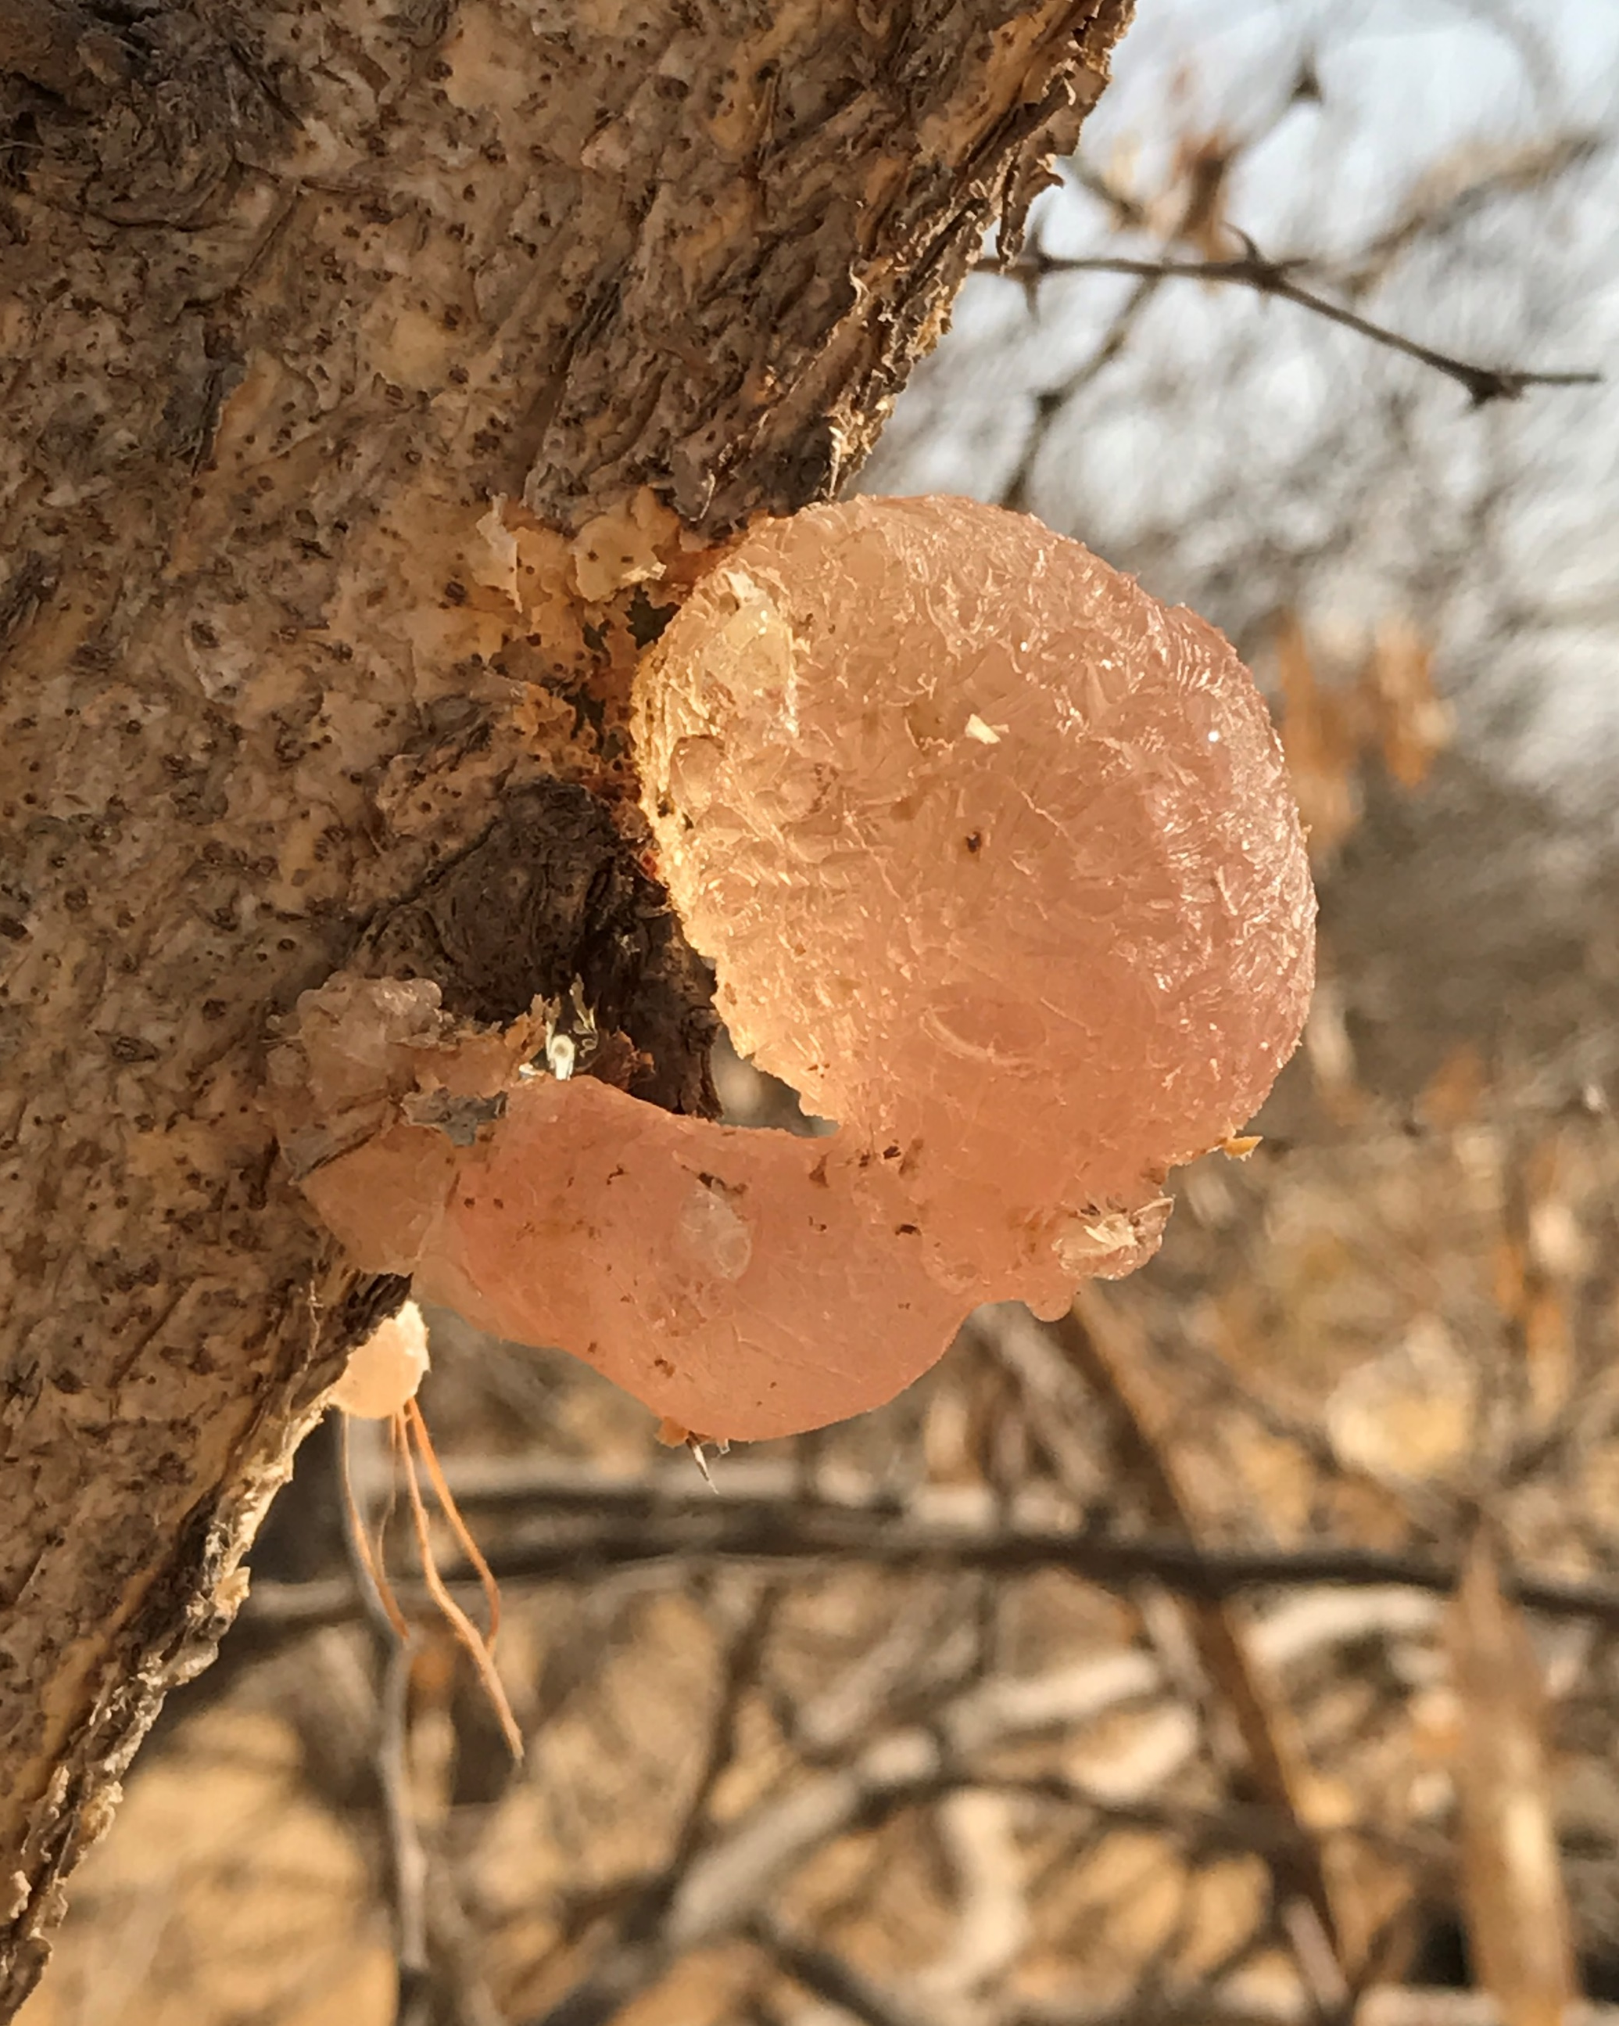


A natural resource
Exudate
of African wild Acacia trees
World
production
65 000 MT
/year

Slide 10

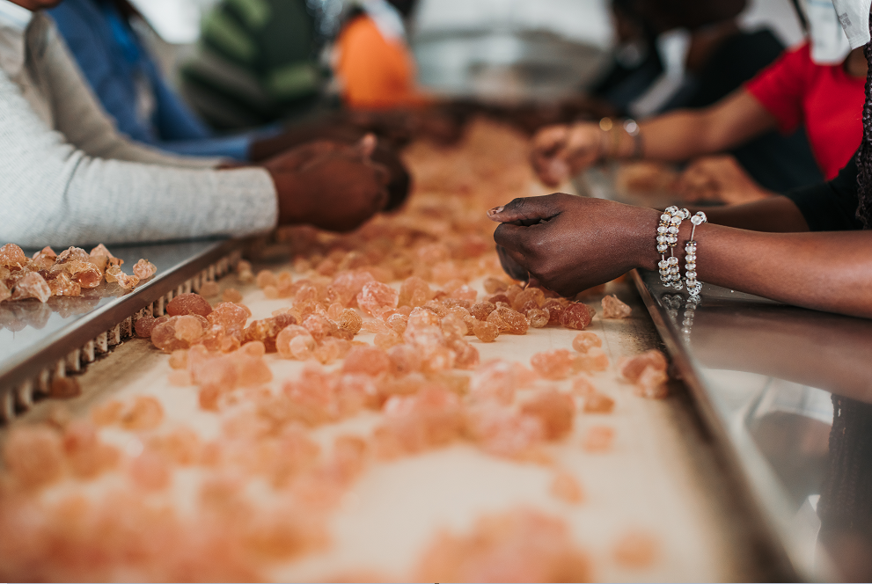






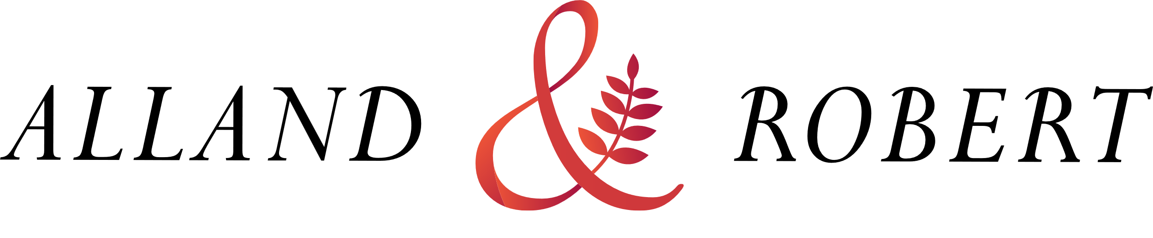
Sourced sustainably directly from nature!
HAND MADE
HARVEST IN THE
GUM BELT
PROVIDE REVENUES
TO LOCAL
POPULATIONS
PREVENT
DESERTIFICATION
TREE FRIENDLY
HARVEST
USED BY MEN AS
A FOOD RESOURCE
FOR MILLENNIA
LOW CARBON
PROCESS
IN THE WHOLE
PRODUCTION CHAIN

Slide 11

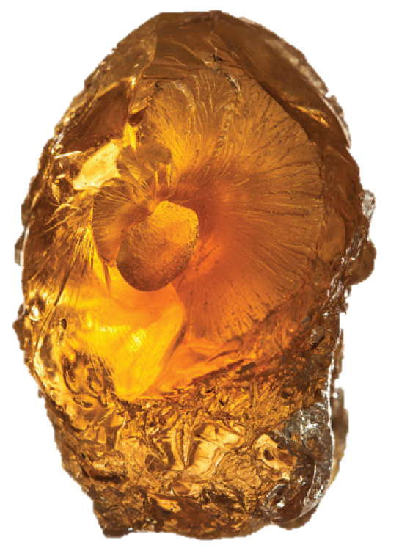




1.
HIGH SAFETY
INGREDIENT
E414
2.
MULTI-FUNCTIONAL
POLYSACCHARIDE
Rhamnose, Galactose, Arabinose, Glucuronic acids
5.
HIGHLY SOLUBLE
IN WATER
3.
VEGETAL, NATURAL,
GMO FREE
6.
LOW CALORIFIC
VALUE
4.
ODOURLESS, TASTELESS,
COLOURLESS

Slide 12






Functional properties
of Acacia Senegal and Seyal
Texturing
Mouthfeel
Improvement
Natural glue
Extrusion
Better textures
and hardness
Softening action
and longer taste
Safe and organic
food adhesive
Processing aid,
gustatory sensation
improver
Emulsion
Fiber
enrichment
Coating
Encapsulation
Emulsifying
properties
and stabilization
90% fiber content,
highly soluble
Film forming abilities,
perfect for gumming
operations
Flavor retention,
protection and use
as a carrier

Slide 13



Acacia gum in dietary
fiber enrichment
ACACIA GUM IS A PREBIOTIC FIBER
AS A FIBER, ACACIA GUM OFFERS
SEVERAL ADVANTAGES
Alland & Robert guarantees
Resistance
to acidity
and heat
Low calorific
value
Very low
glycemic index
A minimum fiber content of 90%
(Measures according to the international method
AOAC 985-29) for all
Acacia Fiber range.
No side effect, discomfort or stomach issues
PH compatible with milk proteins
Scientifically recognized prebiotic effects
Fiber enrichment with acacia gum
can allow nutritional allegations
according to the dosage (« source of » /
« enriched in fibers ») and the regulation
of every country.
Neutral taste
with very low viscosity
Positive effect
on rheology
Non cancerogenic effect
ACACIA, A PREBIOTIC FIBER. NOW FDA APPROVED!

Slide 14

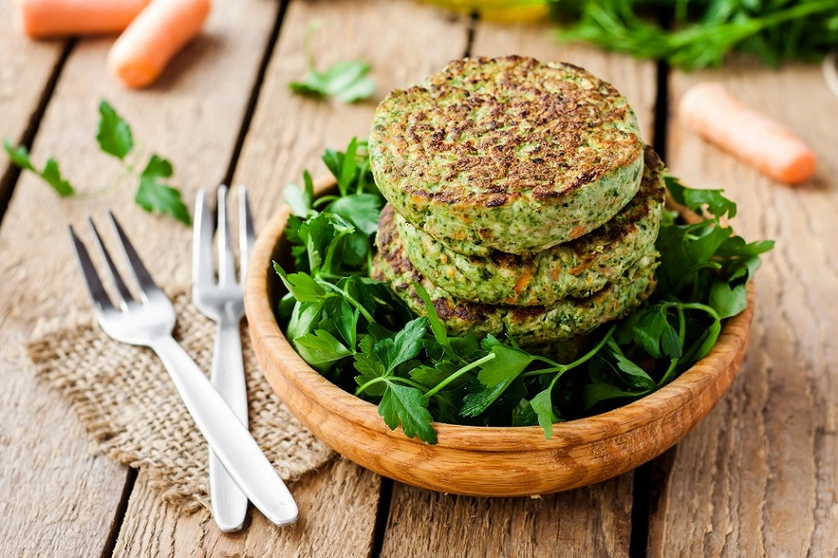






An ingredient in line
with today’s trends
More fiber,
less sugar
Clean & clear label
Vegetarian/
vegan diets
Healthy
& organic food
Sustainable

Slide 15




The benefits of acacia gum
on gut health
Low FODMAP
Acacia gum is a low FODMAP ingredient, which means it is particularly ideal for people with irritable bowel syndrome.
FODMAP stands for Fermentable Oligosaccharides,Disaccharides, Monosaccharides and Polyols: these short chain carbohydrates are poorly absorbed
in the small intestine and can ferment
in the colon, causing digestive
discomforts and issues in some people.
Alland & Robert conducted
an exclusive study on the role played by acacia gum on the gut health & digestive wellness

Slide 16

3.
Introducing Beyond Acacia®

Slide 17





Beyond Acacia®
The only range
of acacia gum with
low carbon footprint
and high dispersion
ability.
LOW CARBON
HIGH DENSITY
Environmental exemplarity with the lowest carbon footprint and a sustainable value chain.
Technological excellence
with the highest density
and dispersion ability.
By using Beyond Acacia®, you can positively affect
the planet and the environment while using a highly
technological and expert product.

Slide 18






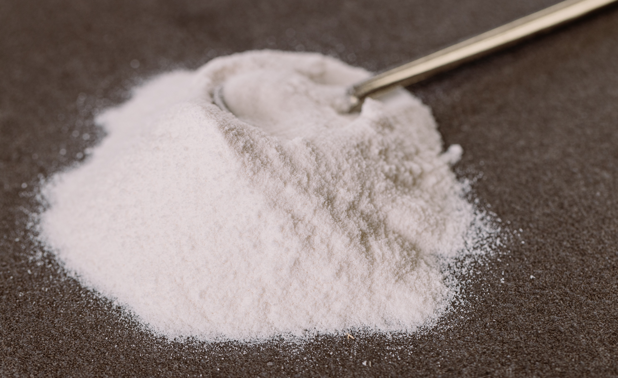

Beyond Acacia®
OUR PRODUCTS
MEET DEMANDING CRITERIA
LABELLING:
• Acacia Gum / Gum Acacia
• Acacia Fibre
• Gum Arabic
• E41
Available as part of the Beyond Acacia® range :
Local legislation should be
checked for labelling options.
Acacia Fibre*
Seyal grades
Senegal grades
BEYOND ACACIA® PRODUCT CHARACTERISTICS
CREAMY WHITE POWDER AVAILABLE IN 25KG PAPER BAGS.
Other packaging available on request.
GMO-free, allergen-free
Halal and Kosher certified
Vegan ingredient
Shelf stable with a shelf life of 3 years
All products are packaged in 25 kg bags.

Slide 19
4.
Technological excellence

Slide 20
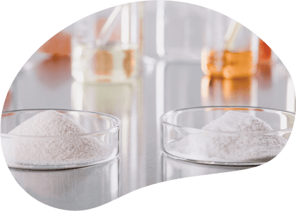





An innovative process
for optimized acacia gum
HIGH DENSITY GRANULES
IMPROVED SOLUBILIZATION even
in cold manufacturing processes
EXCELLENT HYDRATION
Properties
HIGH DISPERSION
Ability
FOAMING REDUCTION
during process
LESS DUSTS during pooring,
excellent flowability & less lumps
Standard Acacia
Beyond Acacia®

Slide 21
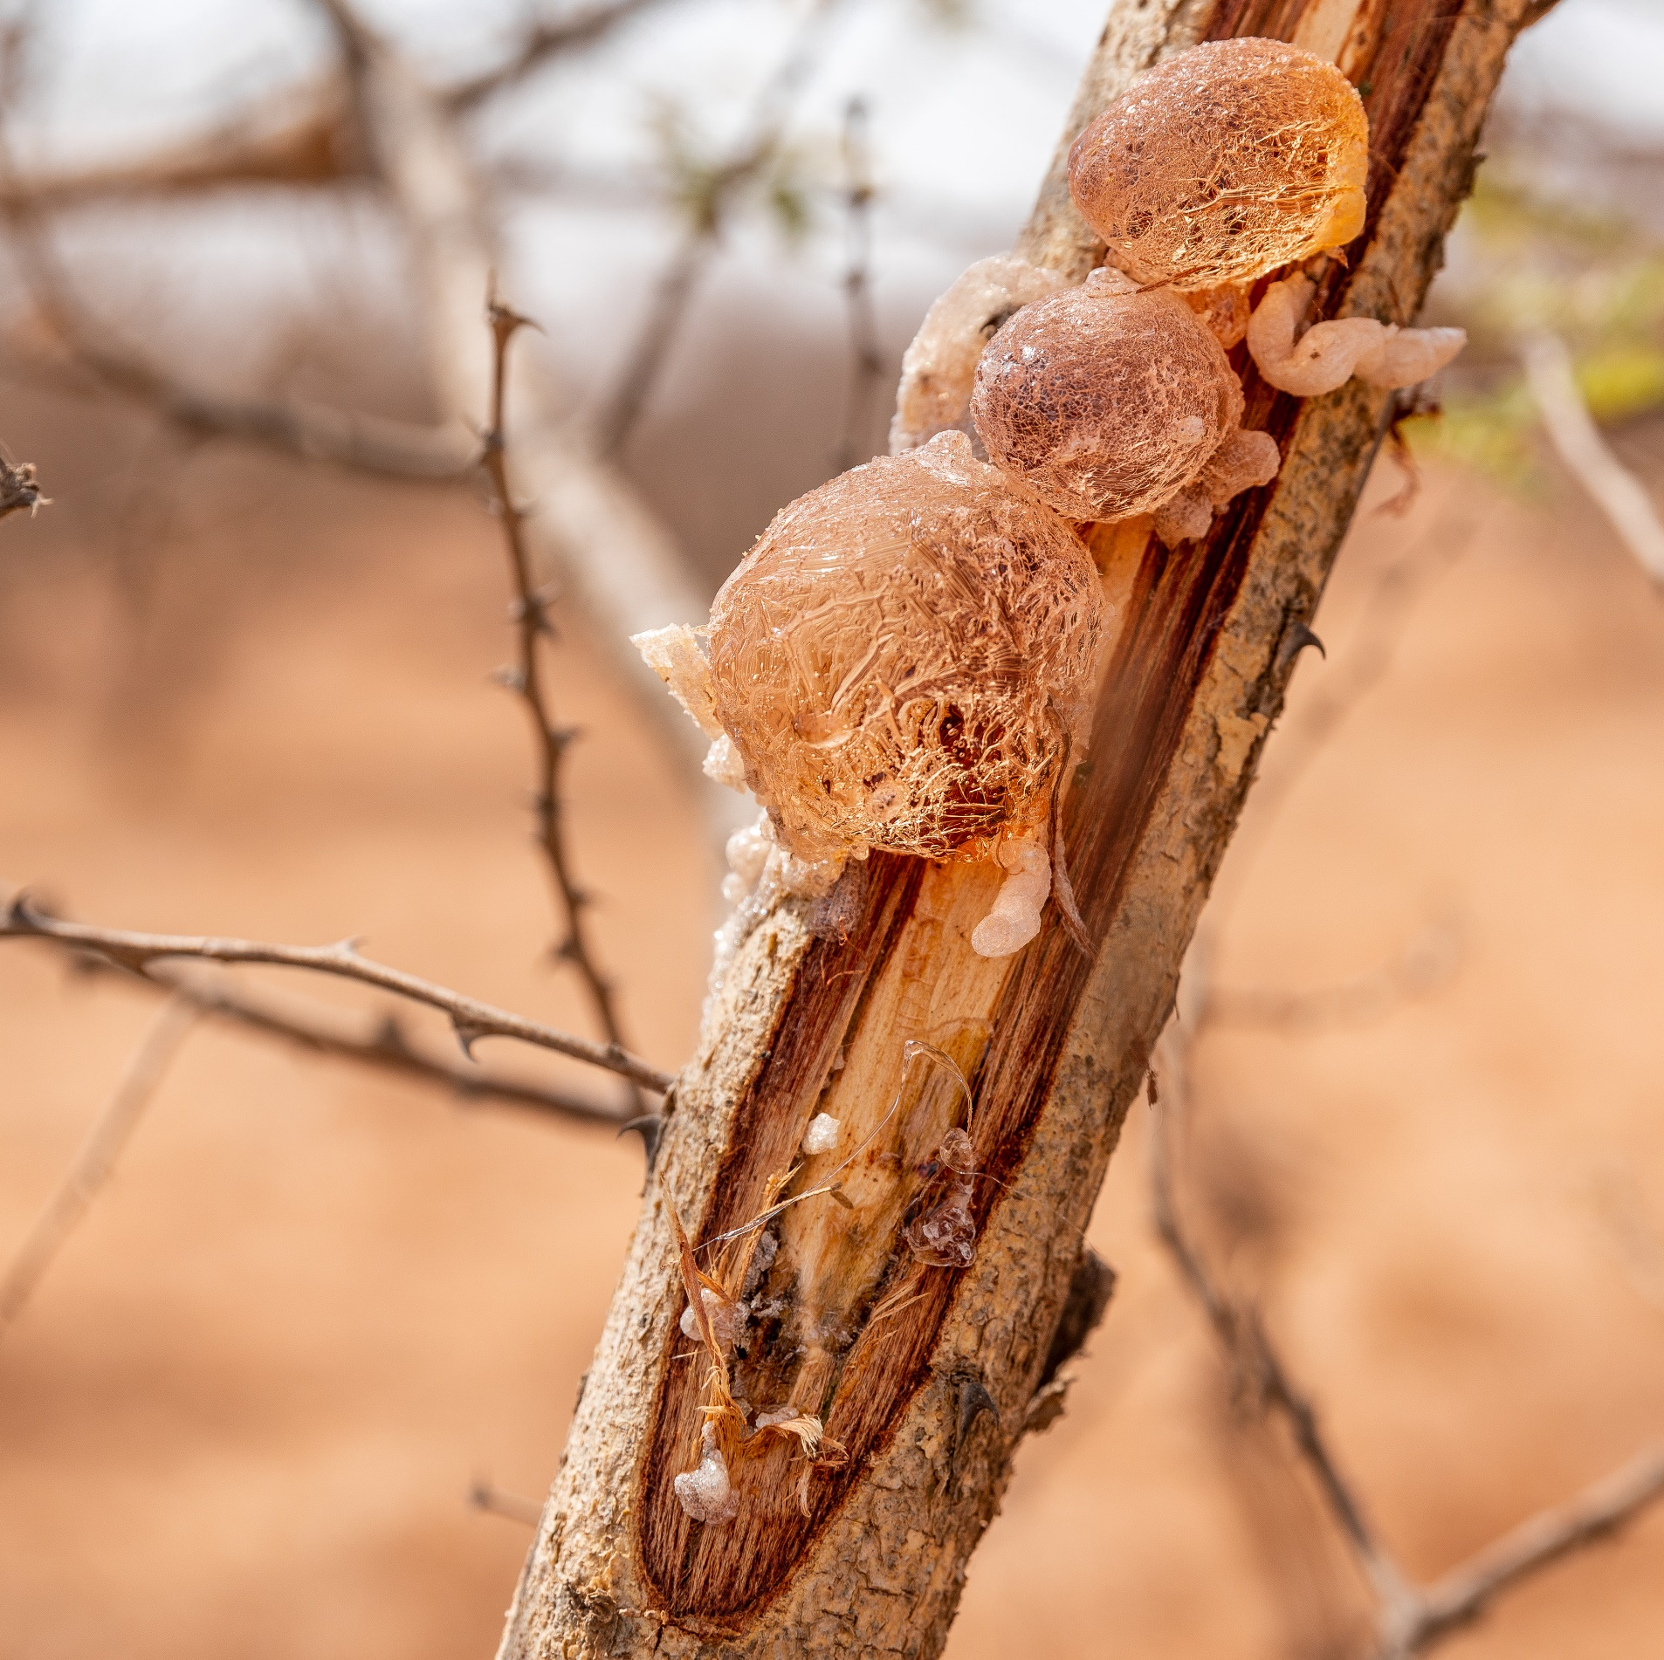
Wettability of gum acacia
in static conditions
100%
90%
80%
70%
60%
50%
40%
30%
20%
10%
0%
86%
66%
16%
All acacia gum
functional properties are preserved: once dissolved
the quality is identical
to regular and instant qualities.
Spraydried
gum acacia
Instant soluble
gum acacia
Beyond
Acacia®
Wettability is the measurement of liquids’ ability of interaction with other fluids and/or solid surface. Beyond Acacia® has a superior wettability, compared to regular gum acacia.

Slide 22
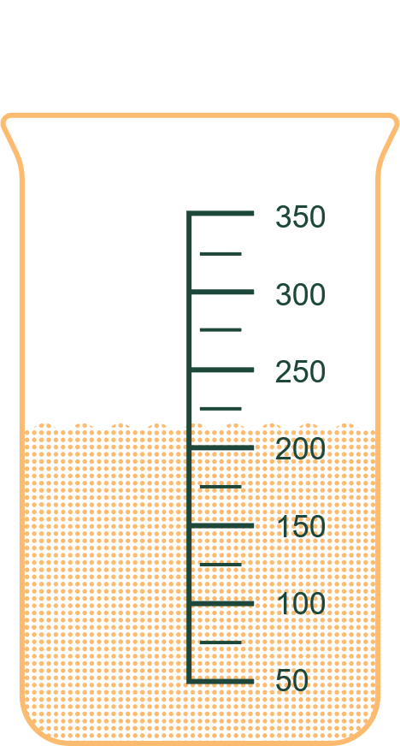


Volume of gum acacia
For a net weight of 100 grams
Regular
spraydried
Standard
instant
Coarse
instant G
Beyond
Acacia©
285ML
250ML
220ML
170ML
-23%
VOLUME vs Spraydried
-32%
VOLUME vs Instant

Slide 23


Reduced energy usage
Better solubilization and higher dispersion ability means less time and energy in the users process.
Complete dissolution, even at high concentration, can be reached without heating.
Volume reduction thanks to the higher density
of the granules.
Packaging reduction, lower storage and shipping volume help optimize logistics and reduce GHG emissions.

Slide 24

5.
Low carbon range

Slide 25






Our global company
is committed to sustainability
IN LINE WITH THE 2015
PARIS AGREEMENT
By 2025,
we will reduce
Alland & Robert is committed
to a low carbon strategy to
keep global warming to well
below 2°C.
BY 20%
ALL GREEN HOUSE
GAS EMISSIONS
per kilo of manufactured
gum (scopes 1, 2 and 3)
for the entire company.

Slide 26

Beyond Acacia®
a comprehensive and genuine approach
-51,1%
of direction
and indirect emissions (scopes 1+2*)
Our commitment
-13,5%
The carbon footprint of Beyond Acacia®
is decreased to a minimum,
compared to standard acacia gum.
of emissions
up and down our value chain (scope 3*)
According to the scopes of the Green House Gaz Protocol, Beyond Acacia® provides on a scope “Craddle To Gate” :
11
million €
Invested
to lower GHG emissions
Committed to energy performance and freight innovation
* Scopes 1, 2 and 3 is a way of categorizing the different kinds of carbon emissions a company creates in its own operations, and in its wider value chain. Scope 2 includes direct and indirect emissions and scope 3 adds all emissions associated to a company up and down its value chain. Scope 3 represents a true evaluation of a product’s environmental impact.

Slide 27
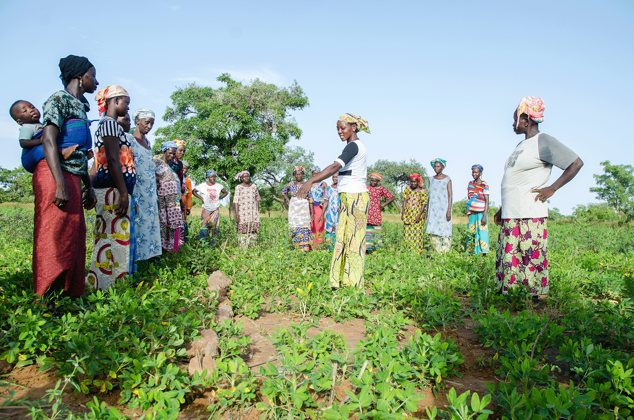


More than carbon
Making a difference in our communities
OUR WORK IN PARTNERSHIP
WITH NGO TREE AID
Our reforestation initiative with TREE AID
1
Support local reforestation of native
trees in their native environment
Since 2020
2
Use the unique properties of trees
to halt desertification and combat
climate change in the Sahel
16 000+trees
3
Contribute to the extraordinary
« Great Green Wall » initiative
planted
in the Sahel on our behalf
4
Carry out field work to support local communities and protect their
environment
5
Restore degraded land and enable
climate resilience for local communities

Slide 28


Beyond Acacia®
Initiate, support and follow various projects in countries where Alland & Robert operates and in Africa.
Make a difference within
the communities where
Alland & Robert sources natural gums with a focus on environment & biodiversity preservation.

Slide 29
Thank you

