Slide 1
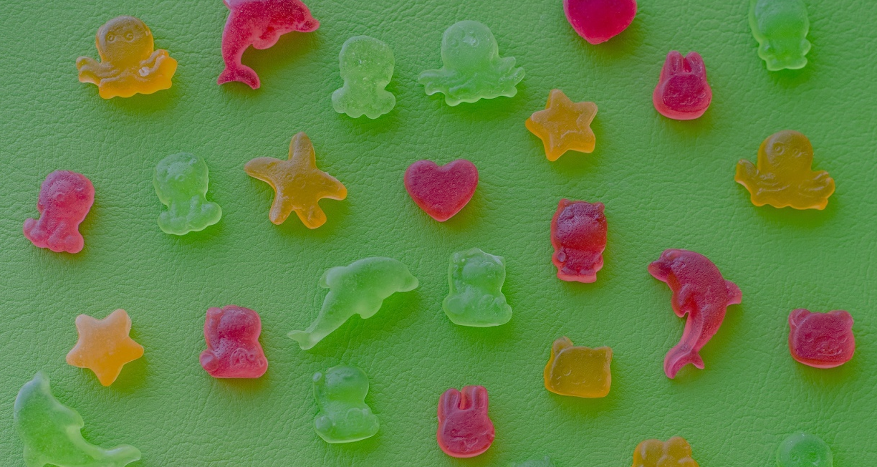



SYNDEO® GELLING
A plant-based gelling agent for ultimate textures
DISTRIBUTORS SESSION INFORMATION
22 & 23th of June, 2023
Alexandra Laplace
Confectionery Expert
Dr. Isabelle Jaouen
R&D Director

Slide 2
BIRTH OF THE IDEA - APPROCH
WHY GELATIN?
Widely used all over the world
Outstanding versatility
No real interesting substitute
Vegan and vegetarian trends
Environmental reasons, animal well fare
Religious reasons
➔ BIG CHALLENGE

Slide 3
BIRTH OF THE IDEA - APPROCH
WHY GELATIN?
Food industries = more than 50% of applications
Many functionalities and properties like acacia gum = many options
Clarifying agent, emulsifier, gelling or whipping agent, stabilizer, thickener
➔ BIG CHALLENGE

Slide 4
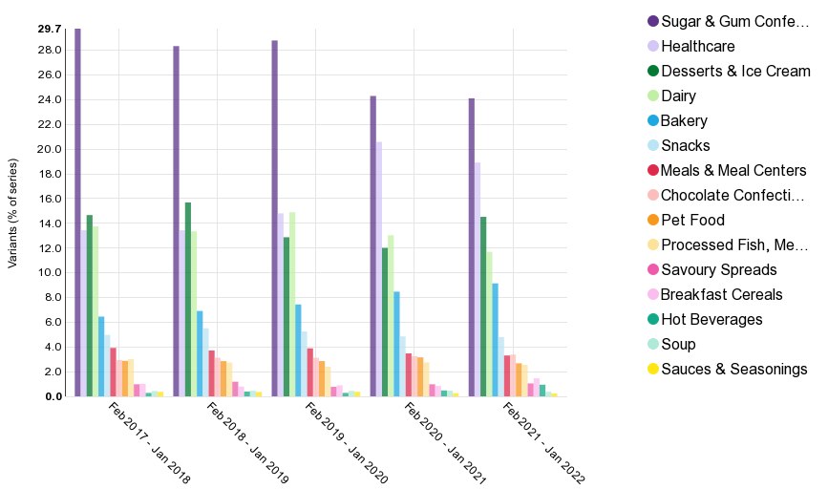
BIRTH OF THE IDEA - APPROCH
70% of products formulated with gelatin:
Confectionery
Healthcare
Desserts & ice creams
Dairies

Slide 5
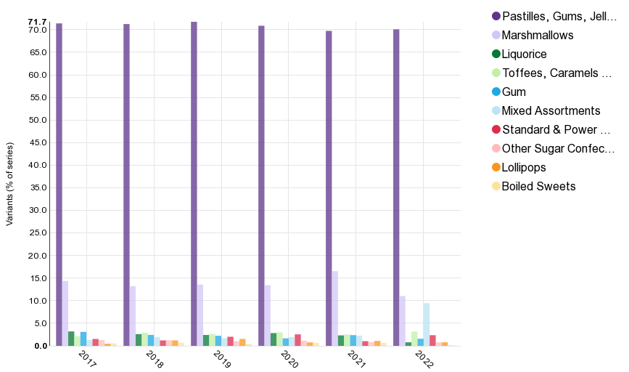
BIRTH OF THE IDEA - APPROCH
80% of confectionery formulated with gelatin
Pastilles, gummies
Marshmallows

Slide 6
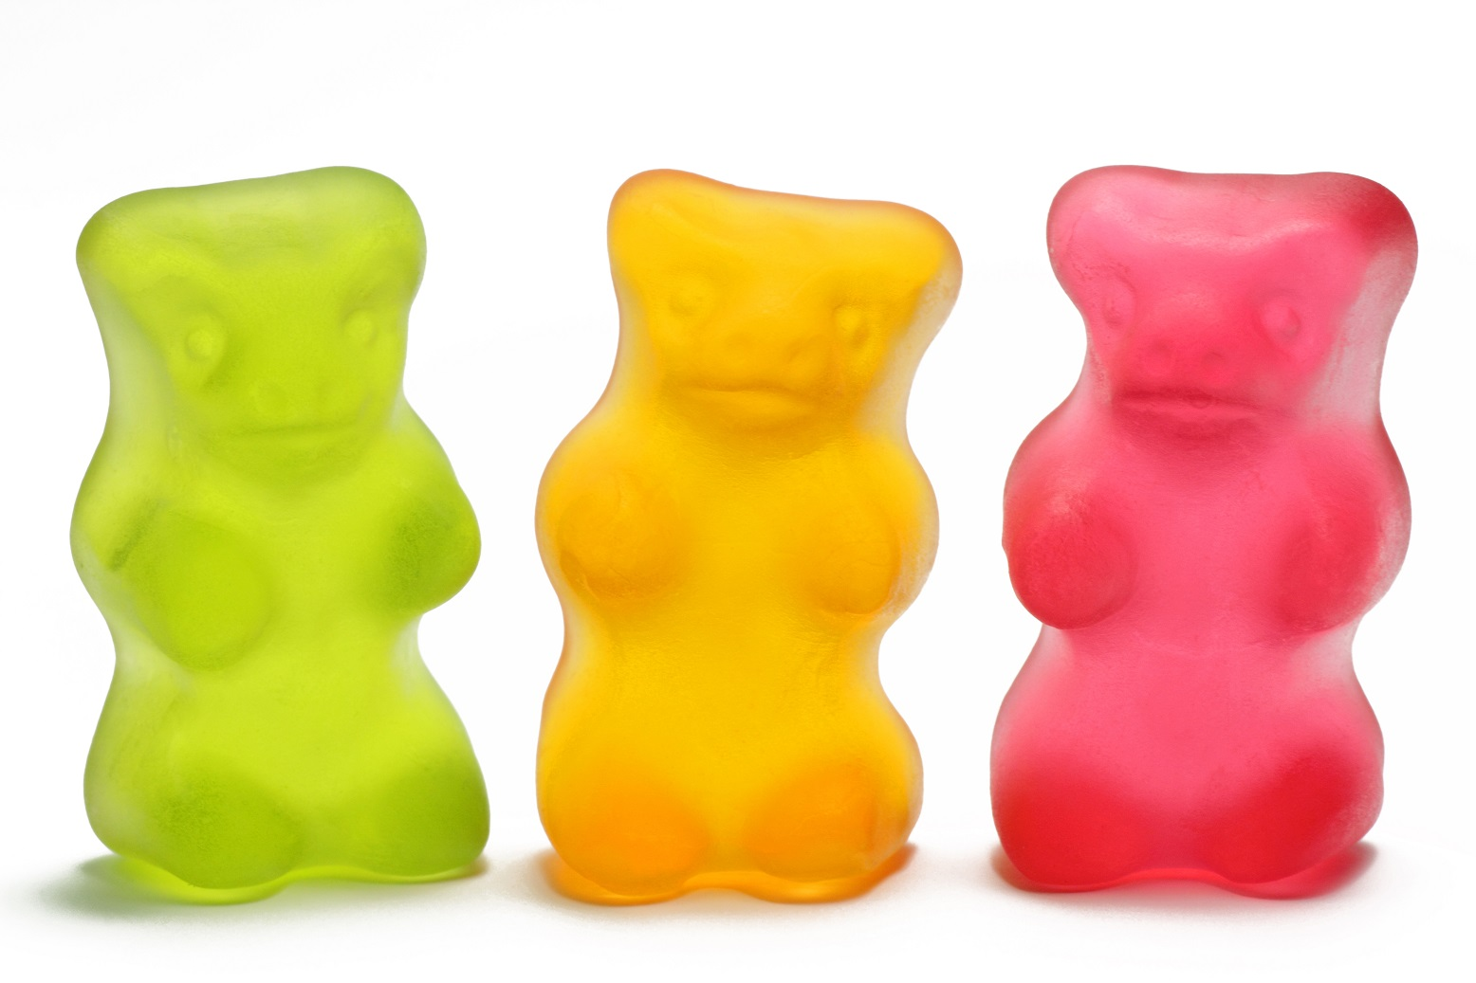
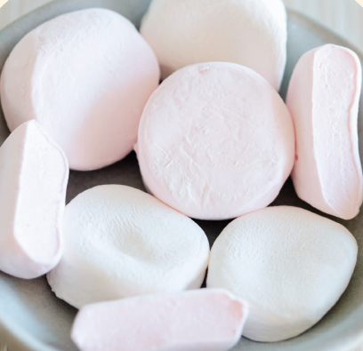

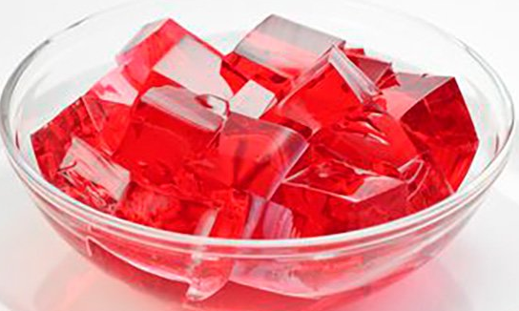
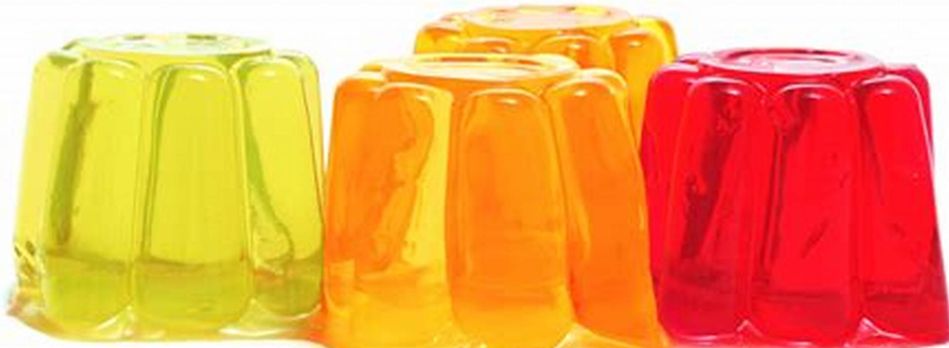
HUNDREDS OF LAB TESTS TO REACH THE RIGHT TEXTURE
Asset : one technician specialized in gummies and candies (trained at German ZDS school)
Tools: instrumental (texturometer) and sensorial tests
Sensory analysis / trained internal panel
A&R knowledge / hydrocolloids
GUMMIES
MARSHMALLOWS
MOUSSES

Slide 7
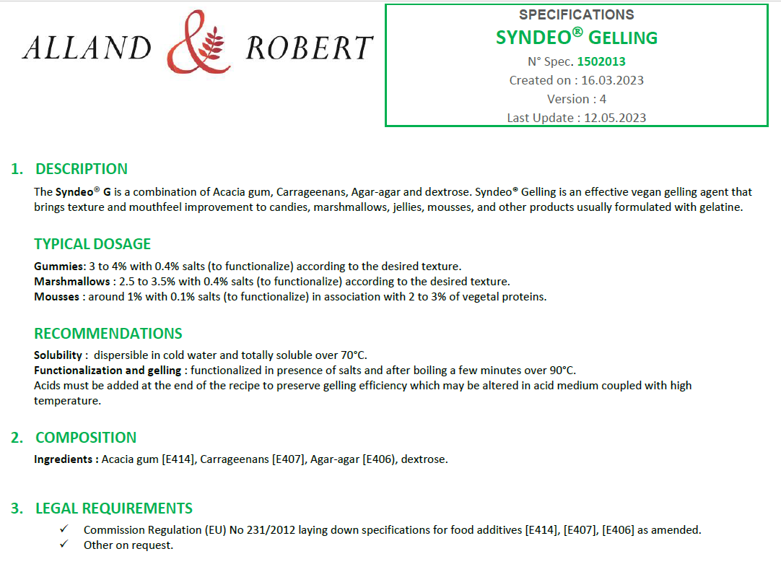
THE FORMULATION
Blend of :
Acacia gum – E414
Carrageenans – E407
Agar – E406
Hydrocolloids commonly used in food
Part C - Group I of REGULATION (EC) No 1333/2008 on food additives
Carrageenan controversy : not degraded in Syndeo G

Slide 8
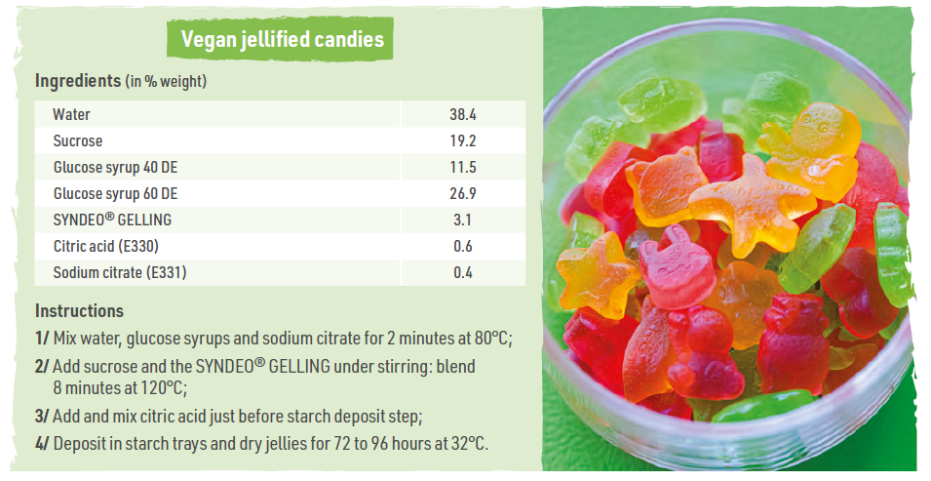
FORMULATION OF VEGAN GUMMIES
Recipe
38.3
19.2
11.5
26.7
3.3
0.6
0.4

Slide 9
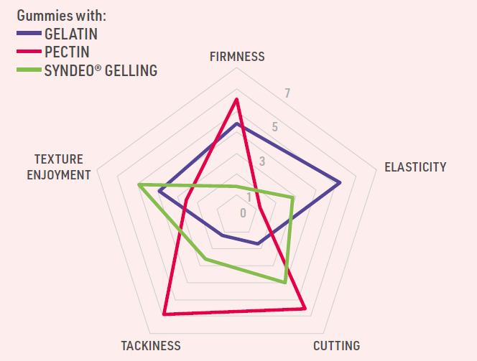
FORMULATION OF VEGAN GUMMIES
Sensory analysis

Slide 10
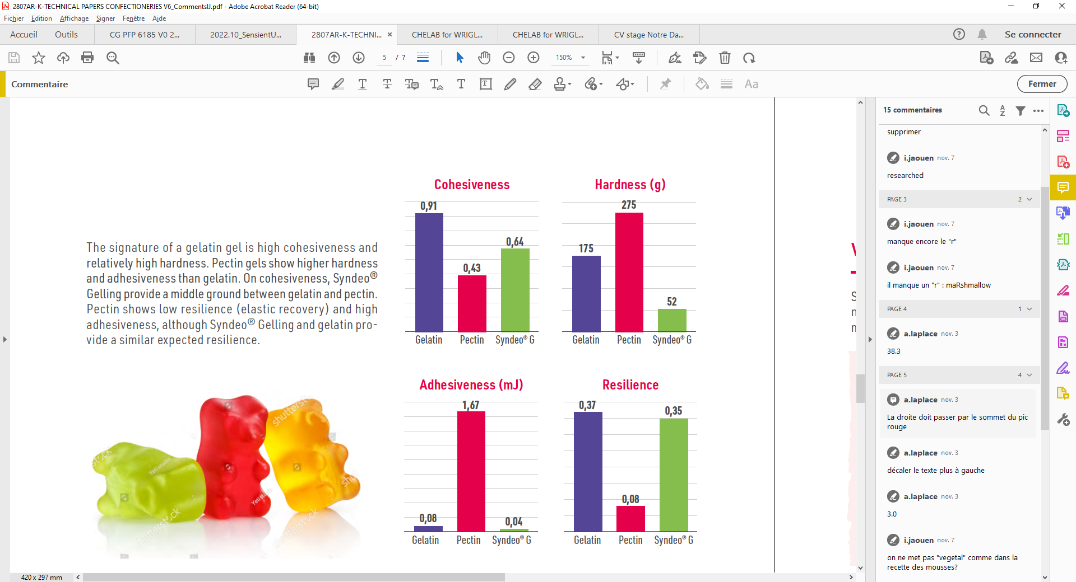
FORMULATION OF VEGAN GUMMIES
Texture Profile analysis

Slide 11
PRODUCTION OF VEGAN GUMMIES
Industrial scale / French confectionery
Identical operating conditions compared to regular gummies formulated with gelatin
Easy depositing step (nice rheology of syrup)
Successful drying process (even at ambient temperature)
Very good feedback from professionals
To take into account : water could be decreased to favour the heating step and nice Brix

Slide 12
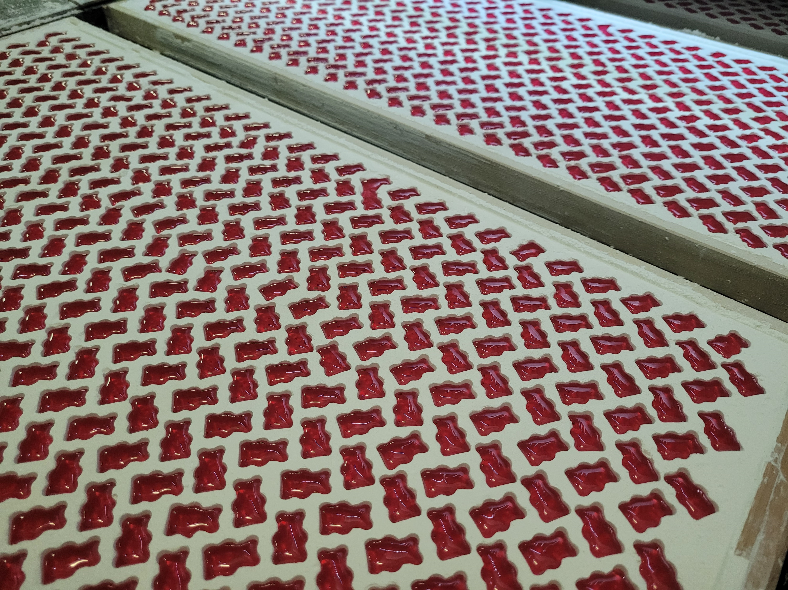
PRODUCTION OF VEGAN GUMMIES
Industrial scale / French confectionery

Slide 13
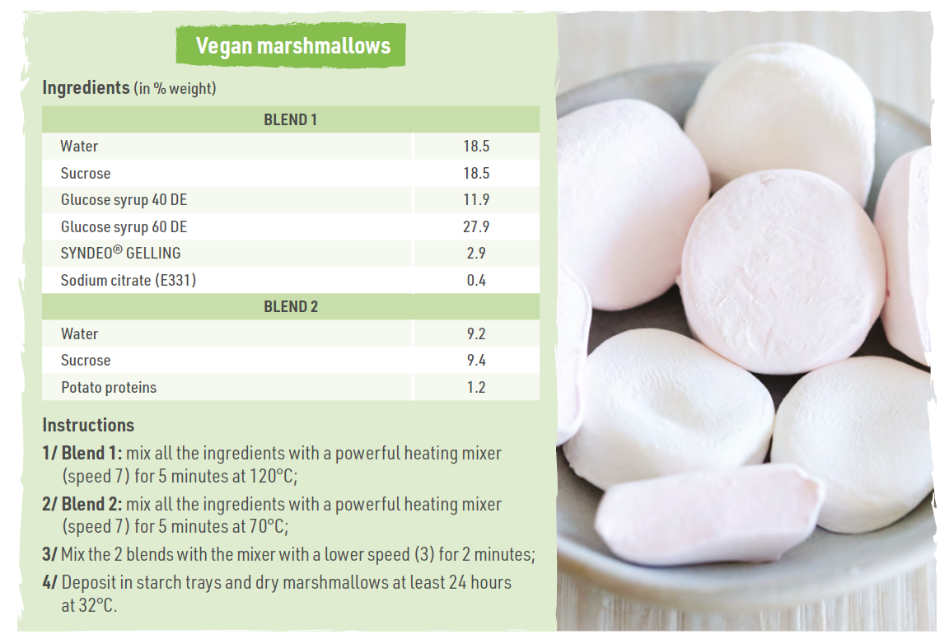
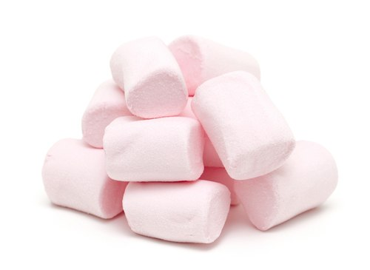
FORMULATION OF VEGAN MARSHMALLOWS
Recipe
18.5
19.0
11.9
27.9
2.5
0.4
9.2
9.4
1.2

Slide 14
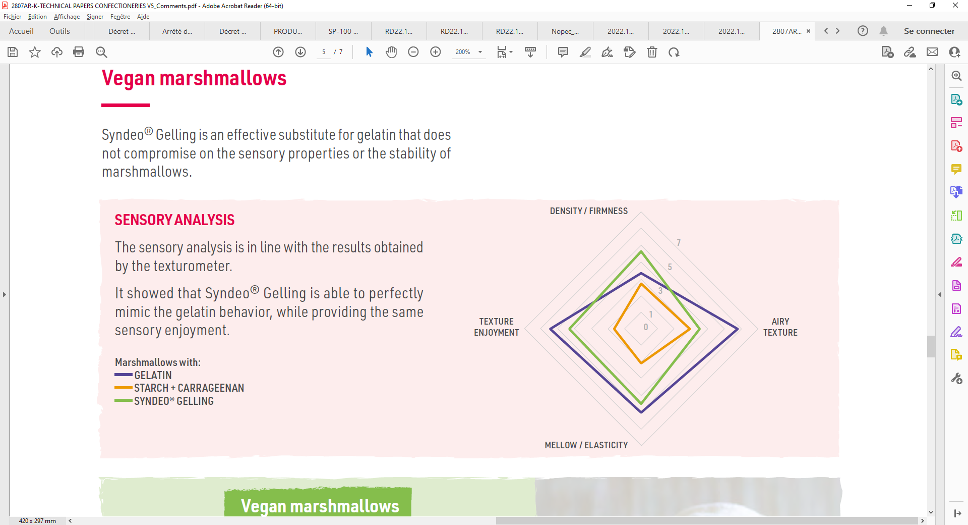
FORMULATION OF VEGAN MARSHMALLOWS
Sensory analysis

Slide 15
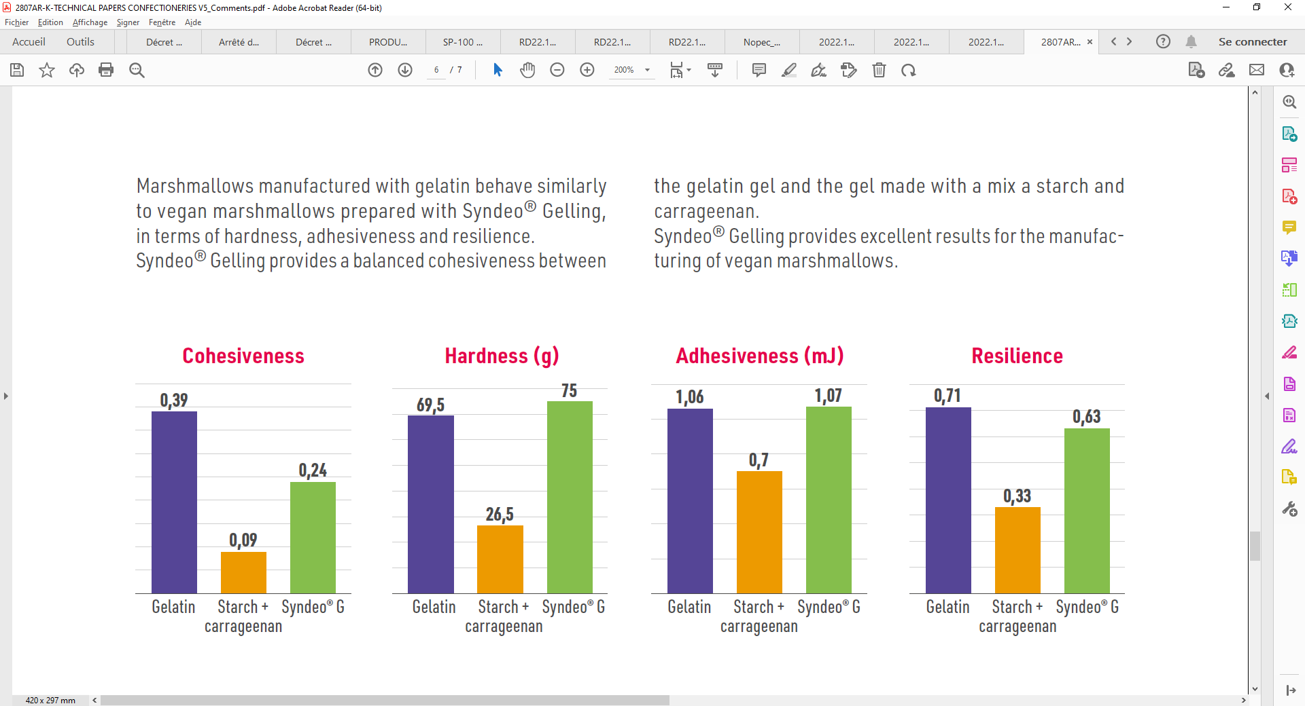
FORMULATION OF VEGAN MARSHMALLOWS
Texture Profile analysis

Slide 16
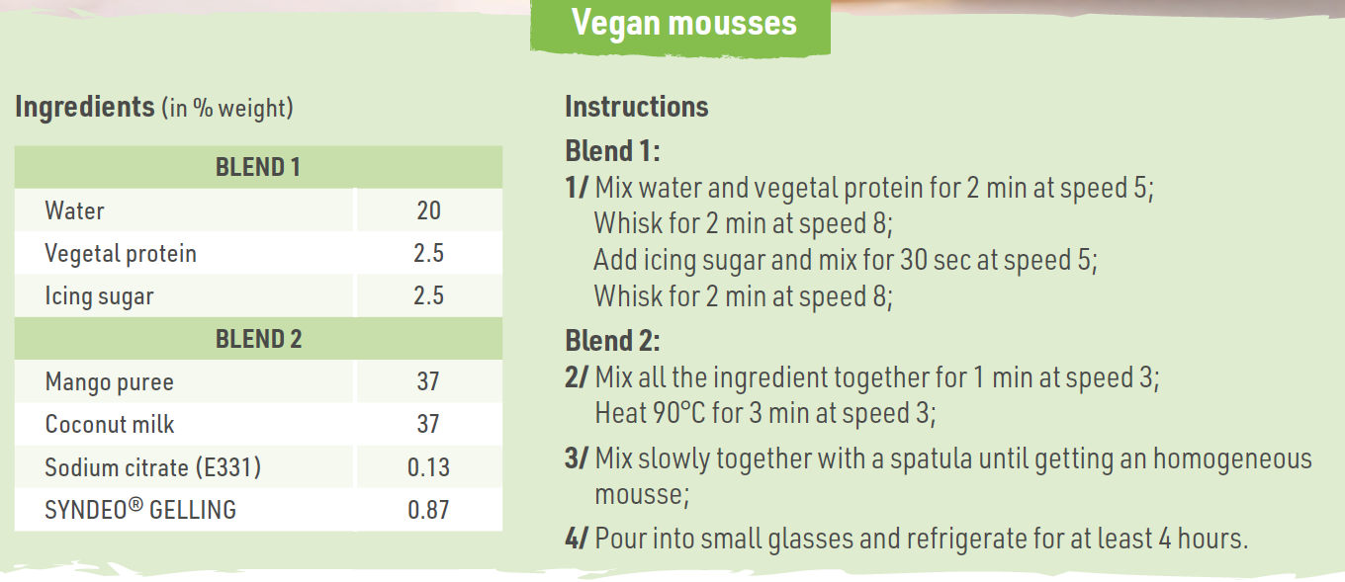
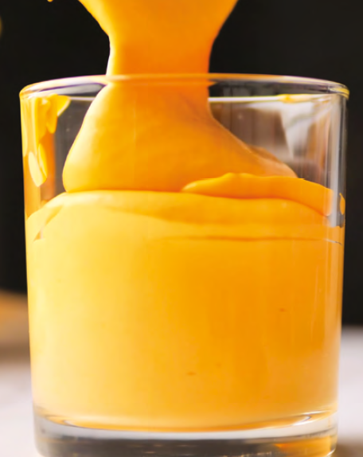
FORMULATION OF VEGAN MOUSSES
Recipe
20
2.5
2.5
37
37
0.13
0.87

Slide 17
GENERAL CONSIDERATIONS
Highlights
Syndeo® G dosing compared to gelatin : 2 to 3 times less depending on the final product
Necessitates salts (Na+) to be functionalized
Easy to dissolve (needs minimal temperature)
May withstands high temperature and acidic conditions compared to gelatin much more sensitive
The Bloom notion in reference to the setting strength of gelatin is not applicable to Syndeo® G.

Slide 18
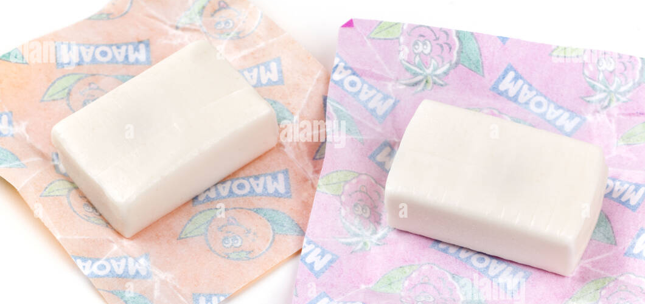
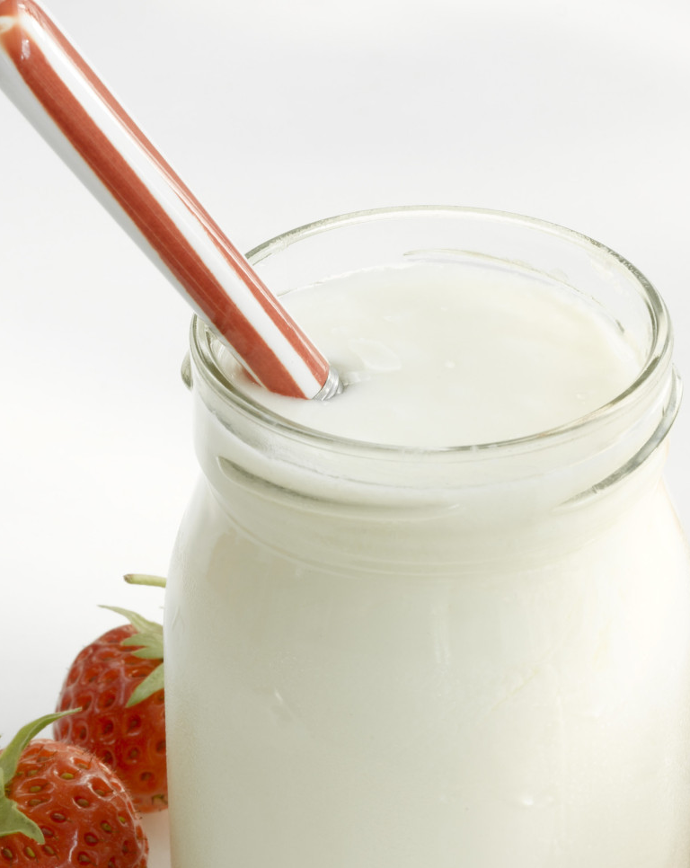
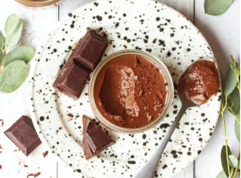
GENERAL CONSIDERATIONS
Next steps
Chewy candies whipped with gelatin
Dairies : yoghurts
Chilled desserts included plant-based trends : pannacottas, creams (spoonable or creamy)

Slide 19
GENERAL CONSIDERATIONS
Conclusion
Mastery of new hydrocolloids in our lab
Look forward to receiving feedback from you and potential customers (about gummies)
A&R technical support to implement our Syndeo® Gelling

Slide 20
THANK YOU FOR ATTENDING !
All our brochures, technical sheets, recipes…
can be DOWNLOADED in our distributor area on
www.allandrobert.com
Contact Violaine if you don’t have a log in and password: v.fauvarque@allandetrobert.fr
Alexandra Laplace
Confectionery Expert
a.laplace@allandetrobert.fr
Dr. Isabelle Jaouen
R&D Director
i.jaouen@allandetrobert.fr

